Slide 1

ADVANCED SQL PROJECT
IMDB DATASET
RIYA RAJESH
23-05-2025
DA-DS, March Batch.

Slide 2

DATASET OVERVIEW:
Database Name: Internet Movie Database.
Tables Created:
1. Movie: Main table holding movie-level metadata.
Fields include id, title, year, date_published, duration, country, gross_income, languages, and production_company.
Primary key: id.
2. Genre: Many-to-one mapping of genres to movies.
Composite primary key: movie_id, genre.
3. Director_mapping: Maps movies to directors (identified by name_id).
Composite primary key: movie_id, name_id.

Slide 3
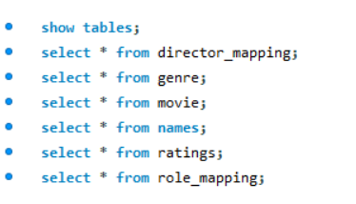
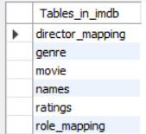
4. Role_mapping: Maps actors and crew to movies, including their category (e.g., actor, actress, writer).
Composite primary key: movie_id, name_id.
5. Names: Person-level data.
Includes name, height, date_of_birth, and known_for_movies.
Primary key: id.
6. Ratings: Ratings and votes data for each movie.
Includes avg_rating, total_votes, median_rating.
Primary key: movie_id.

Slide 4


OBJECTIVE:
The primary objective of this project is to:
Reinforce key SQL concepts such as joins, aggregation, filtering, and grouping.
Analyze and extract meaningful insights from a real-world movie dataset.
Document, present, and improve communication skills by creating a detailed report and a presentation of findings.

Slide 5
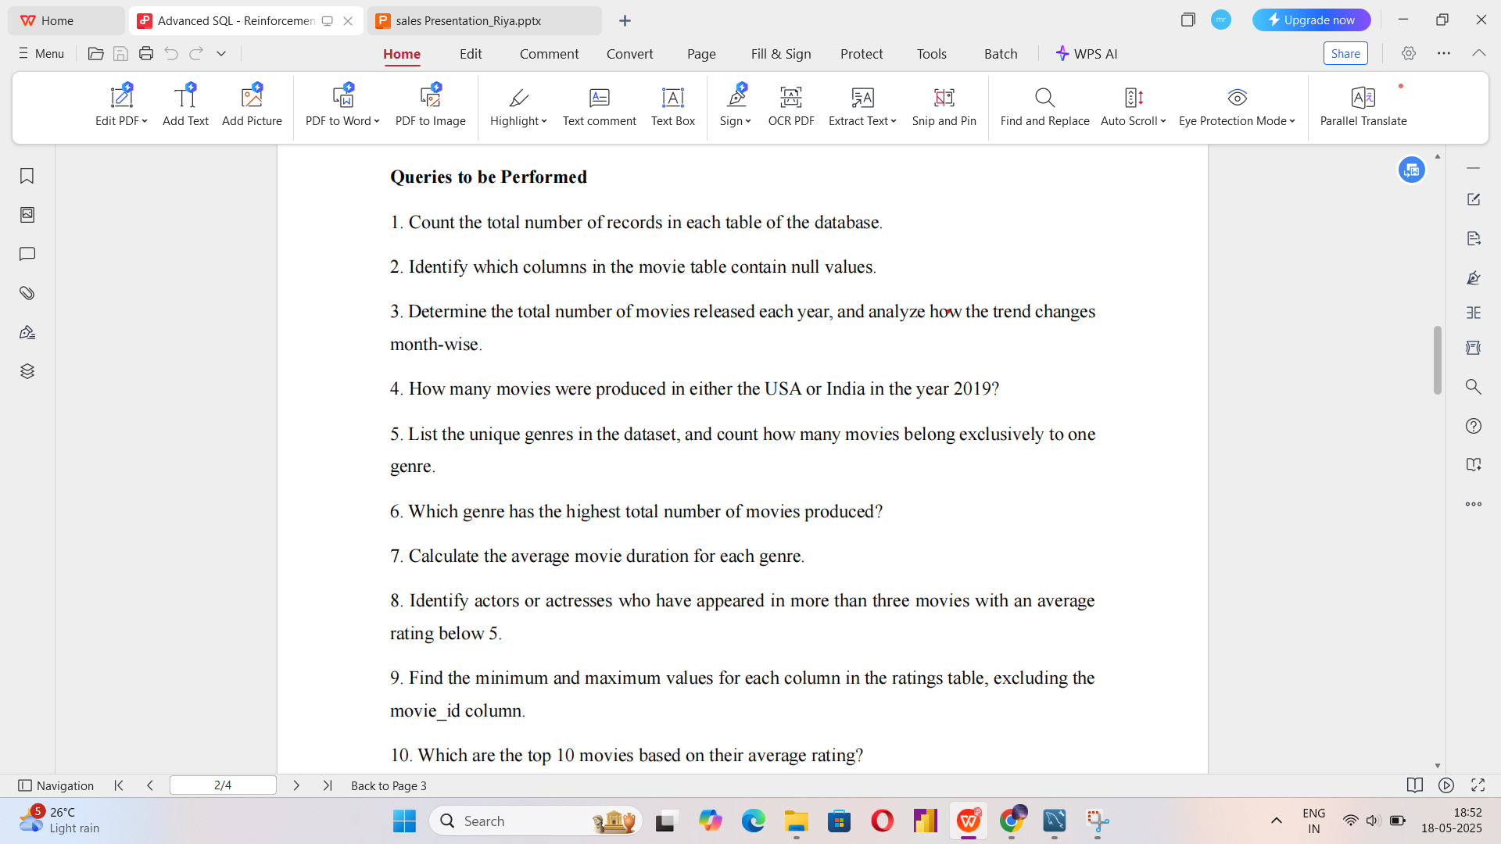
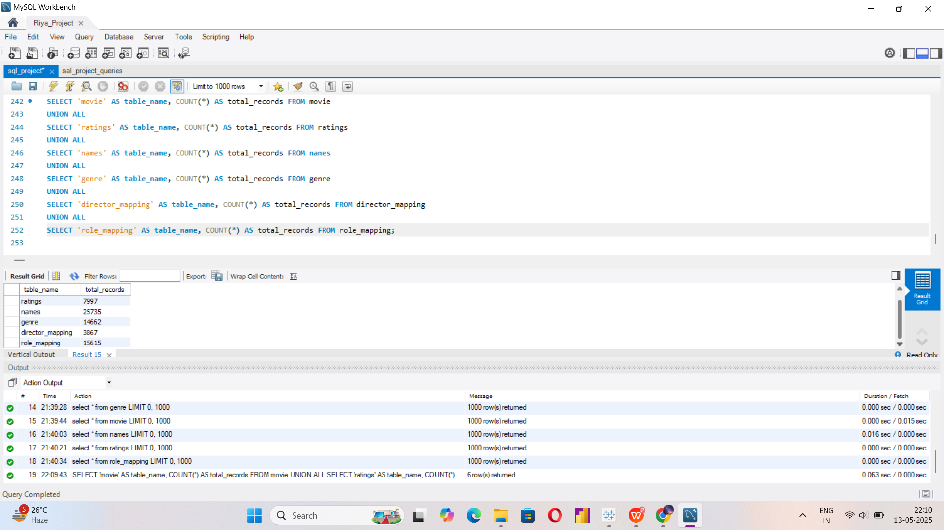
QUERIES PERFORMED:
Query:
Output:

Slide 6

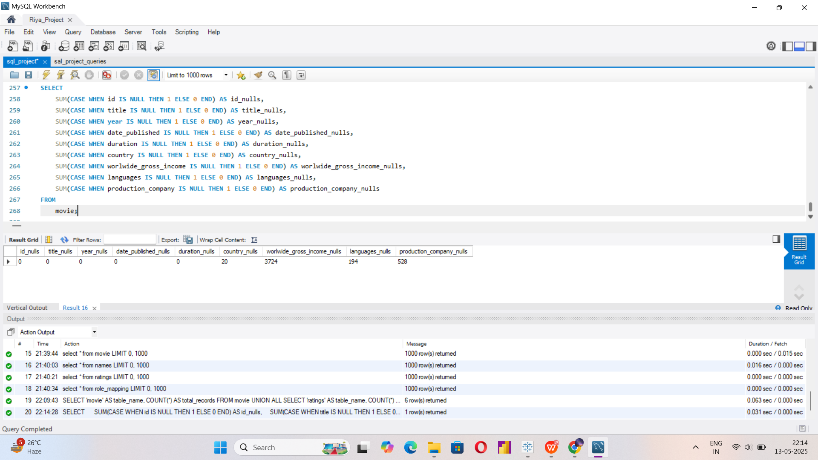

Slide 7
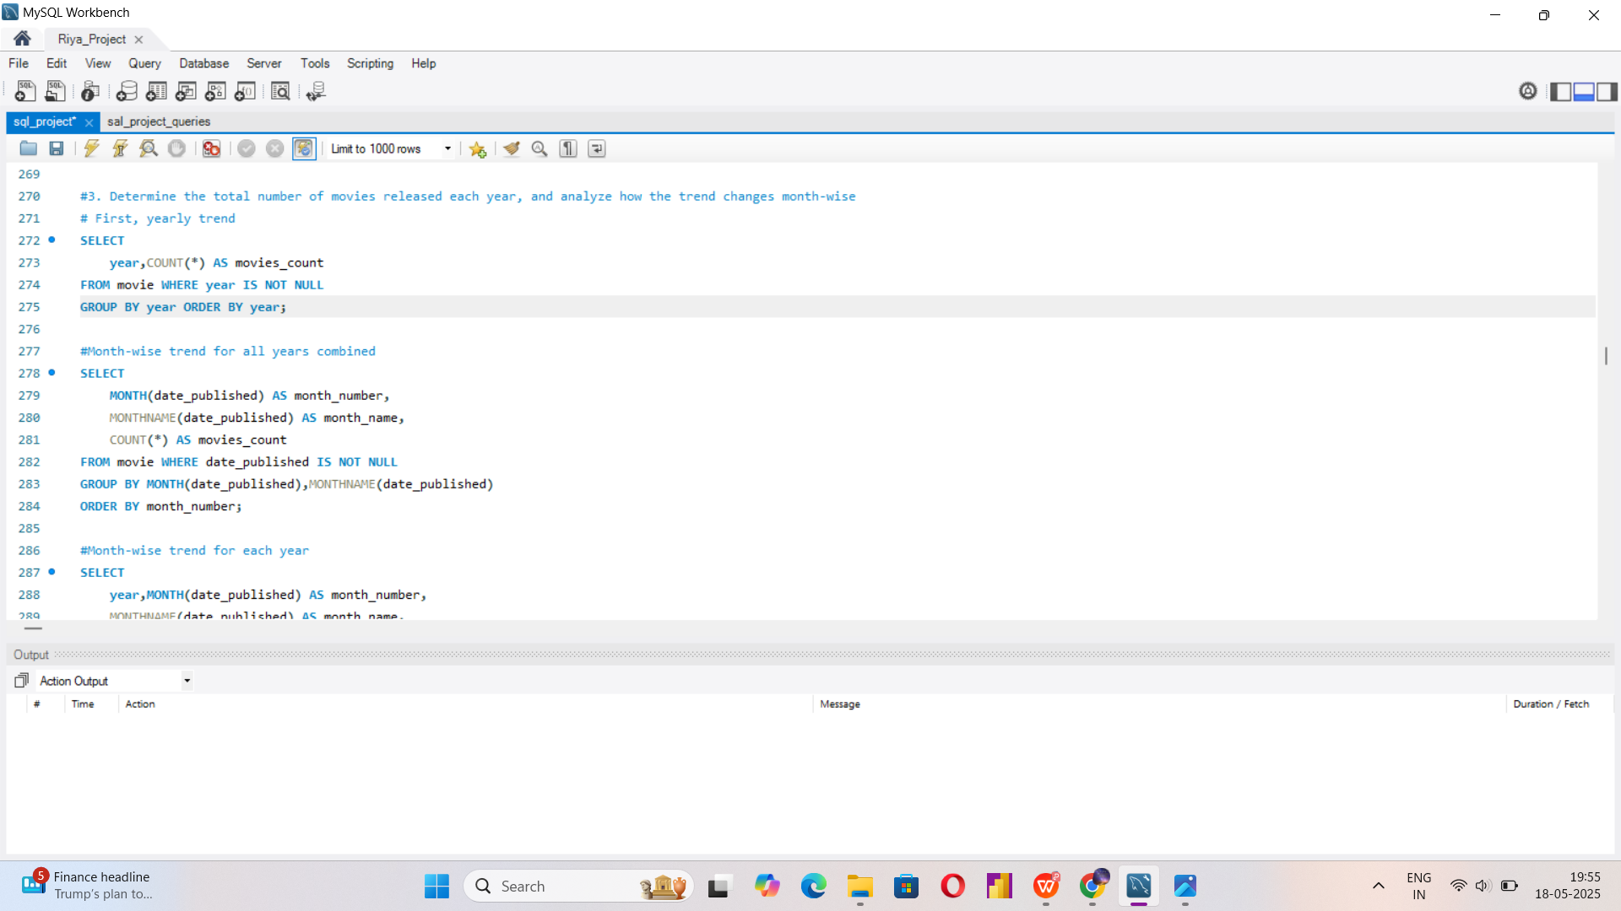
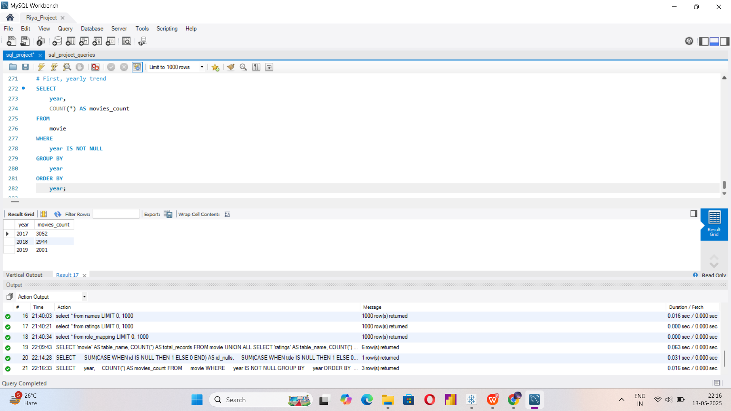
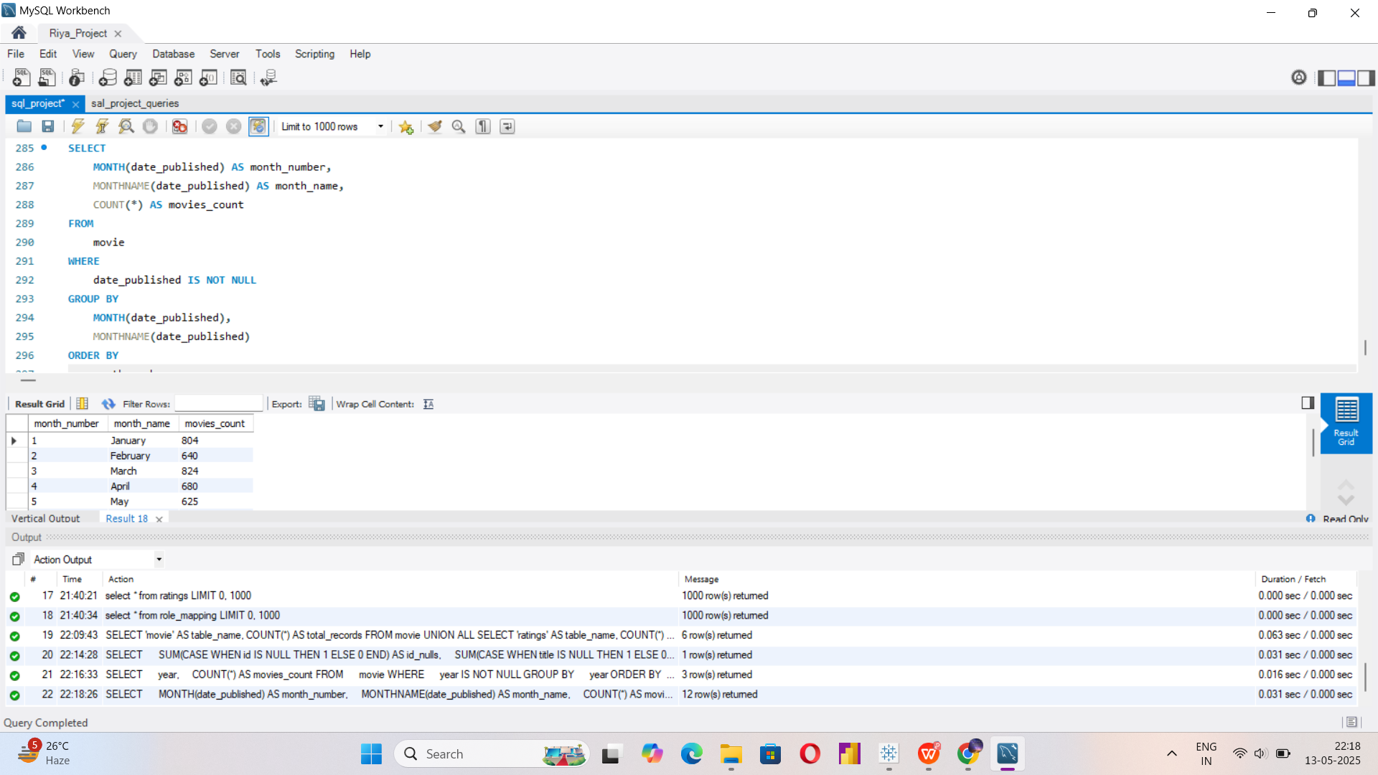

Slide 8
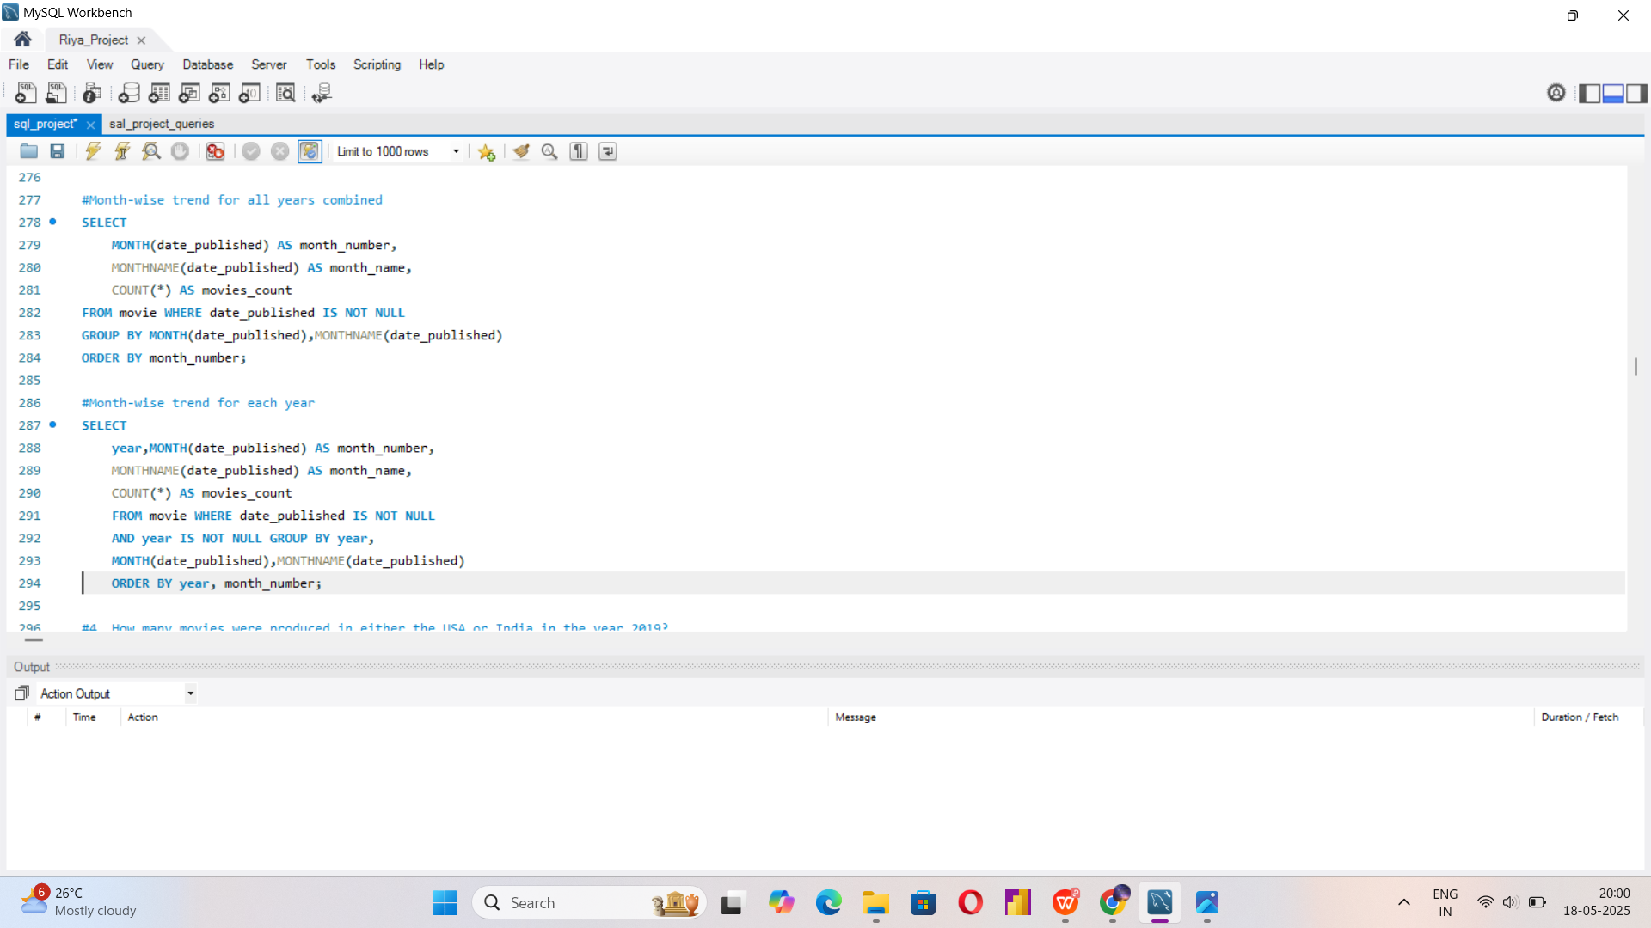
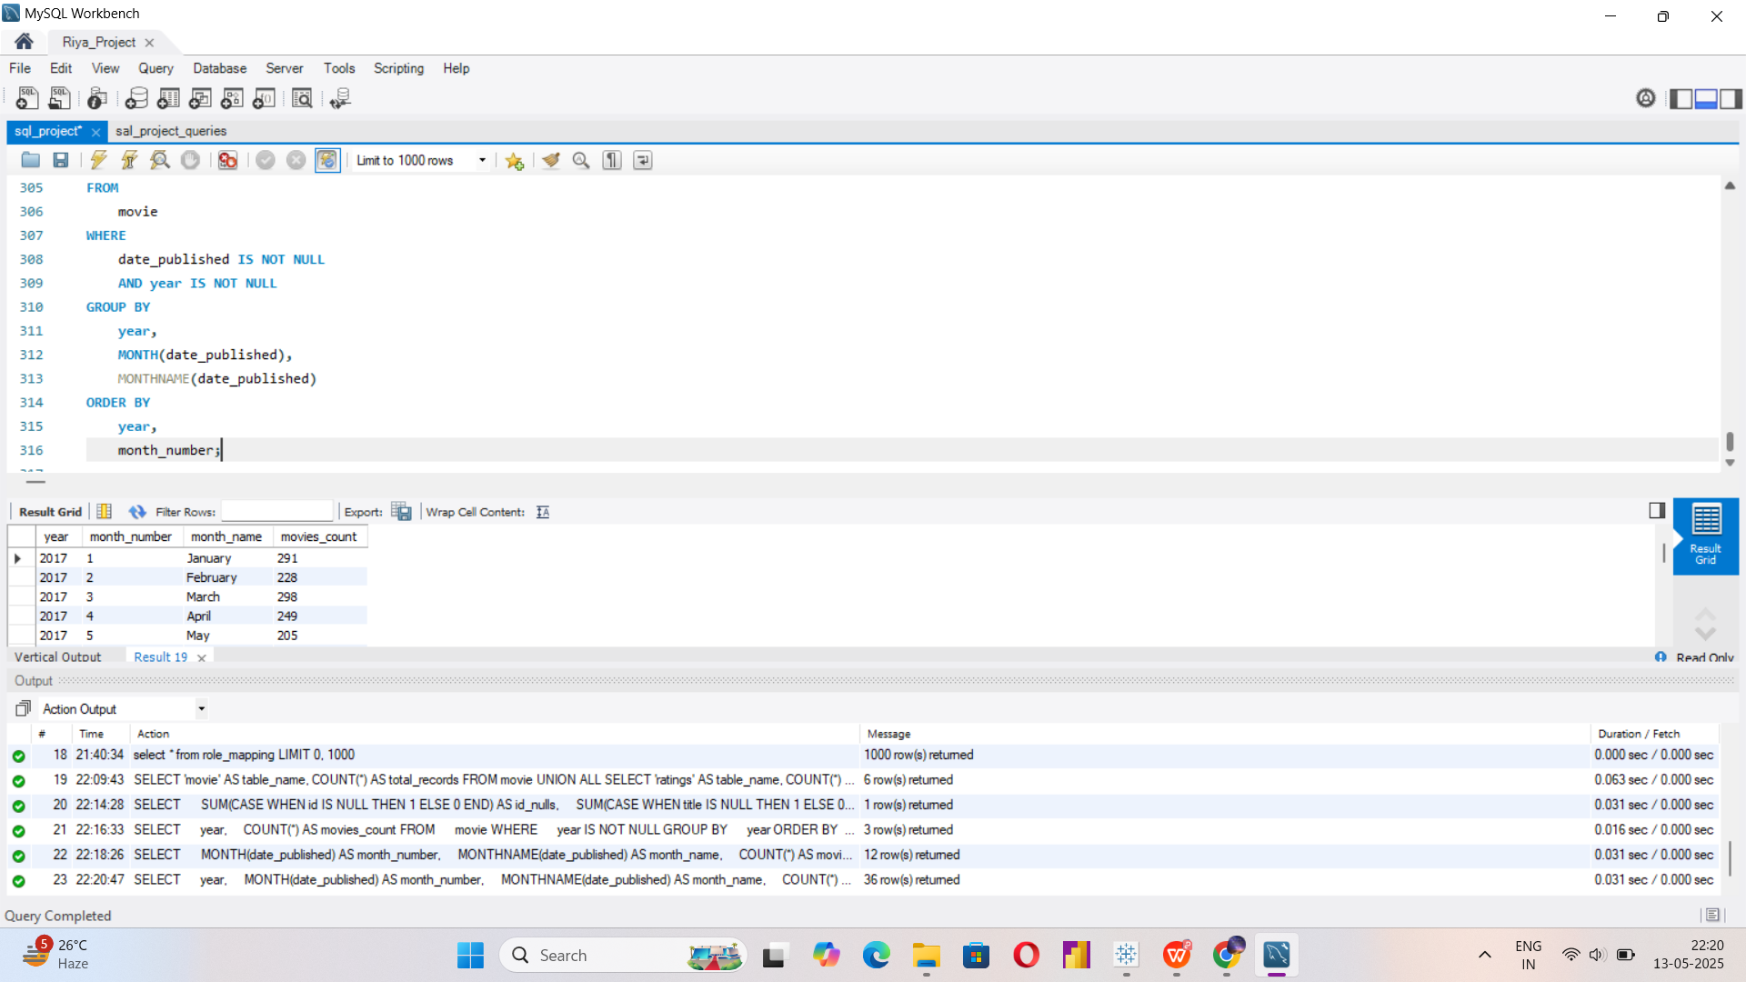

Slide 9
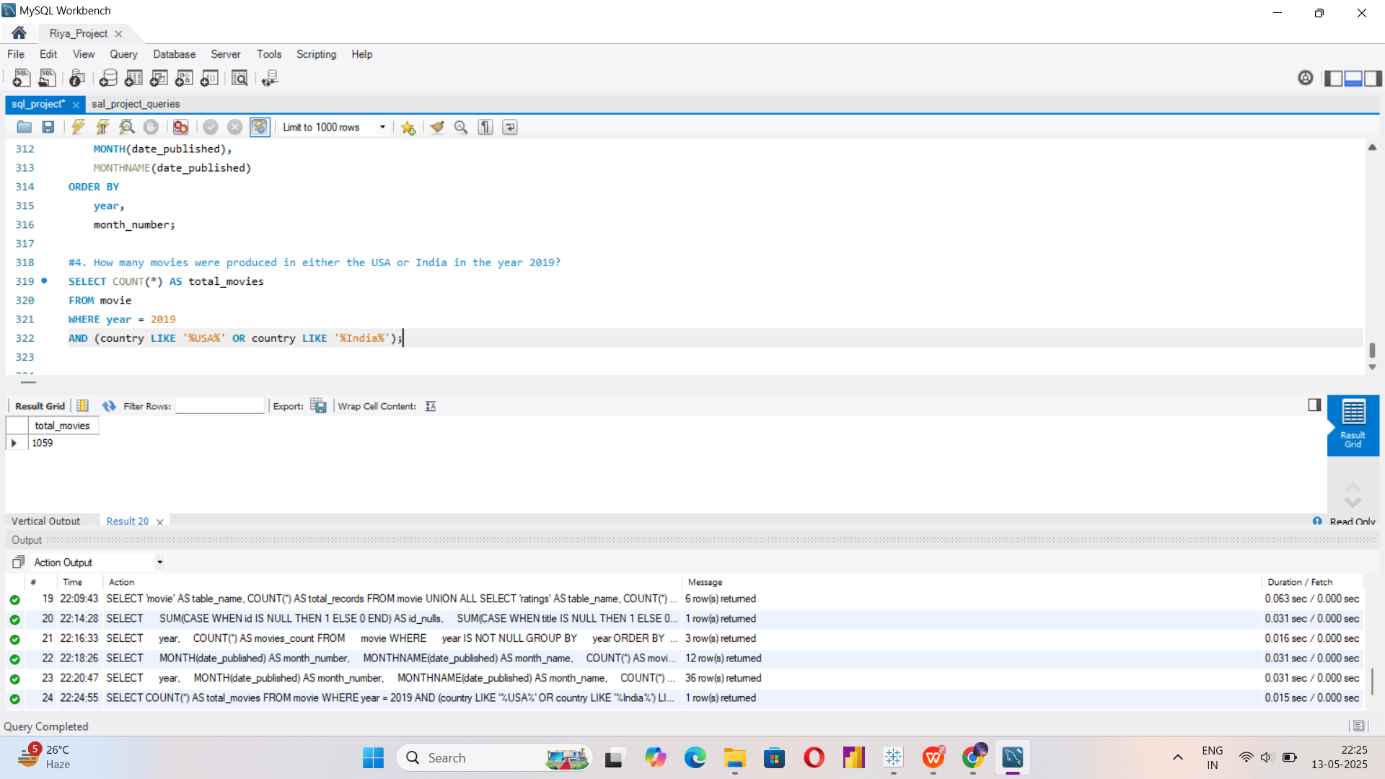

Slide 10
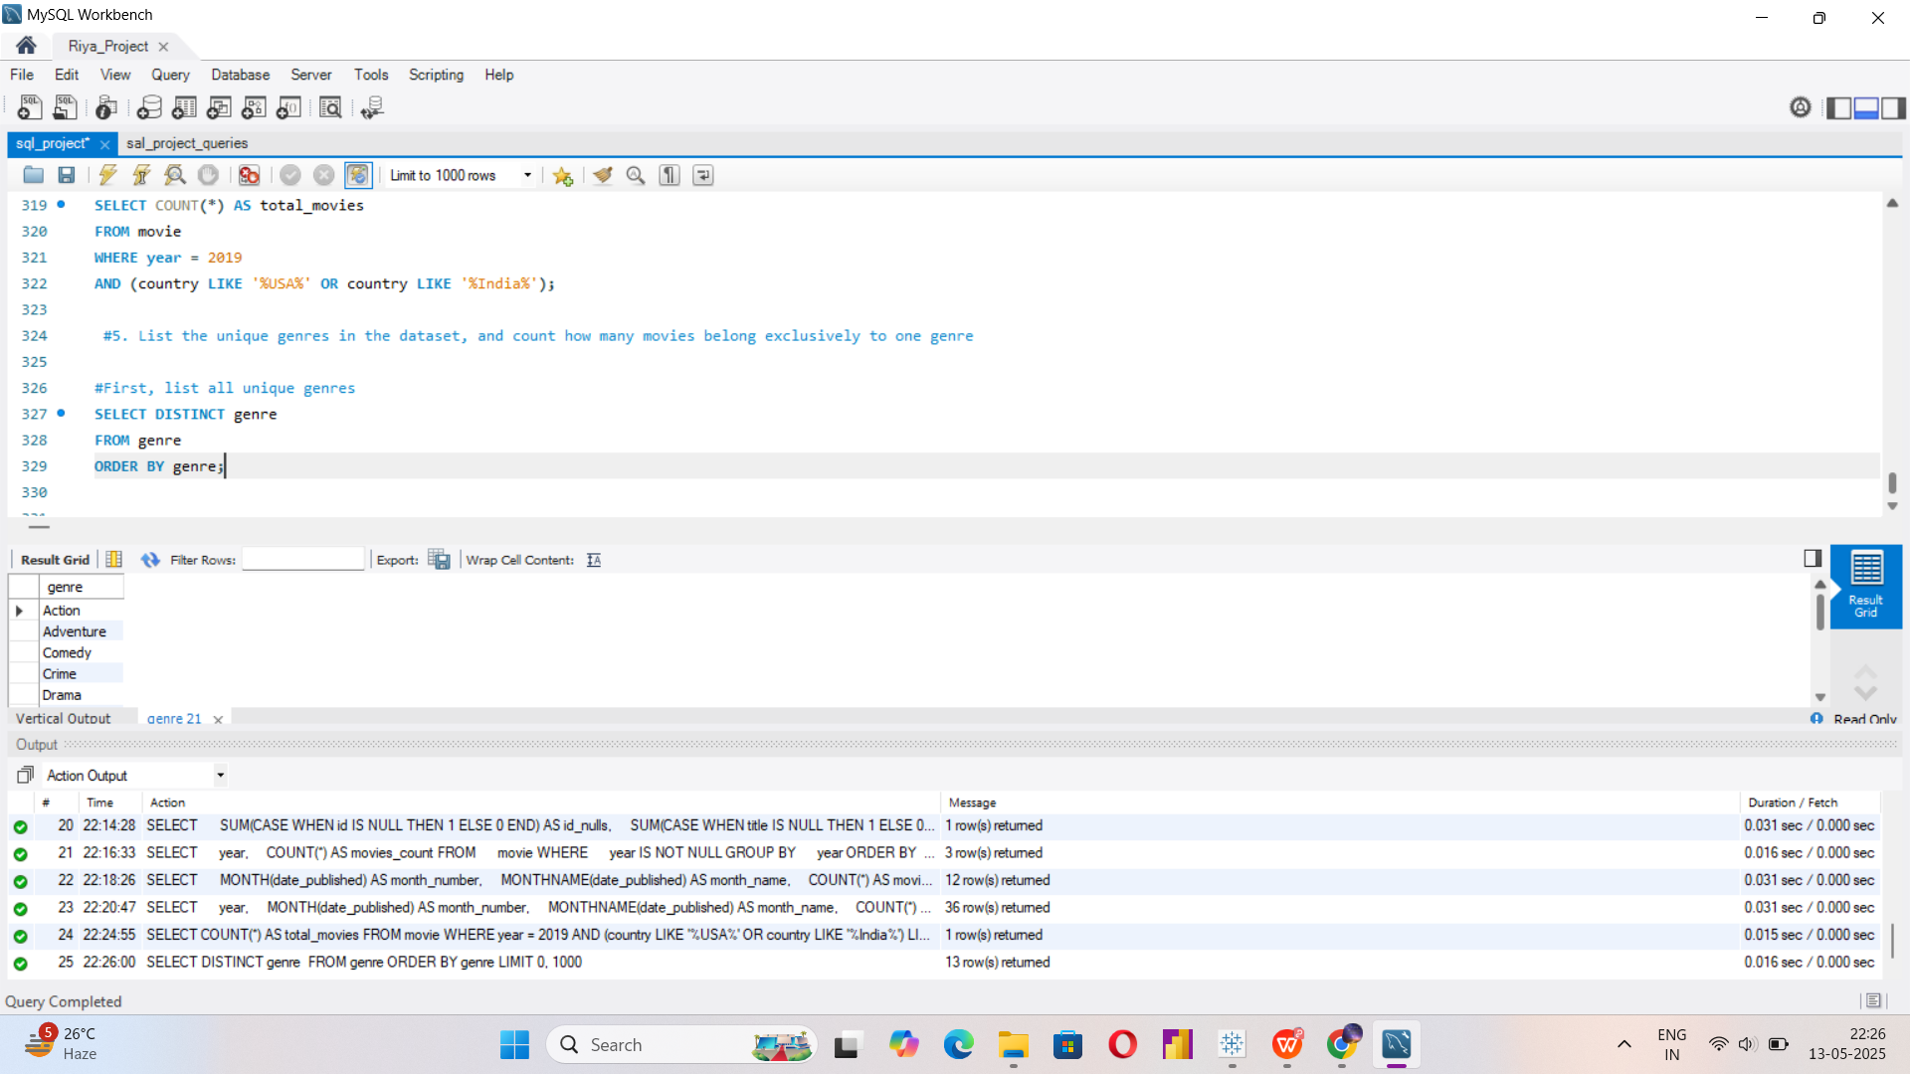
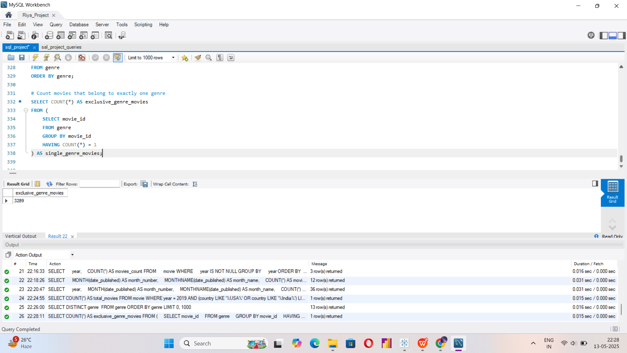


Slide 11
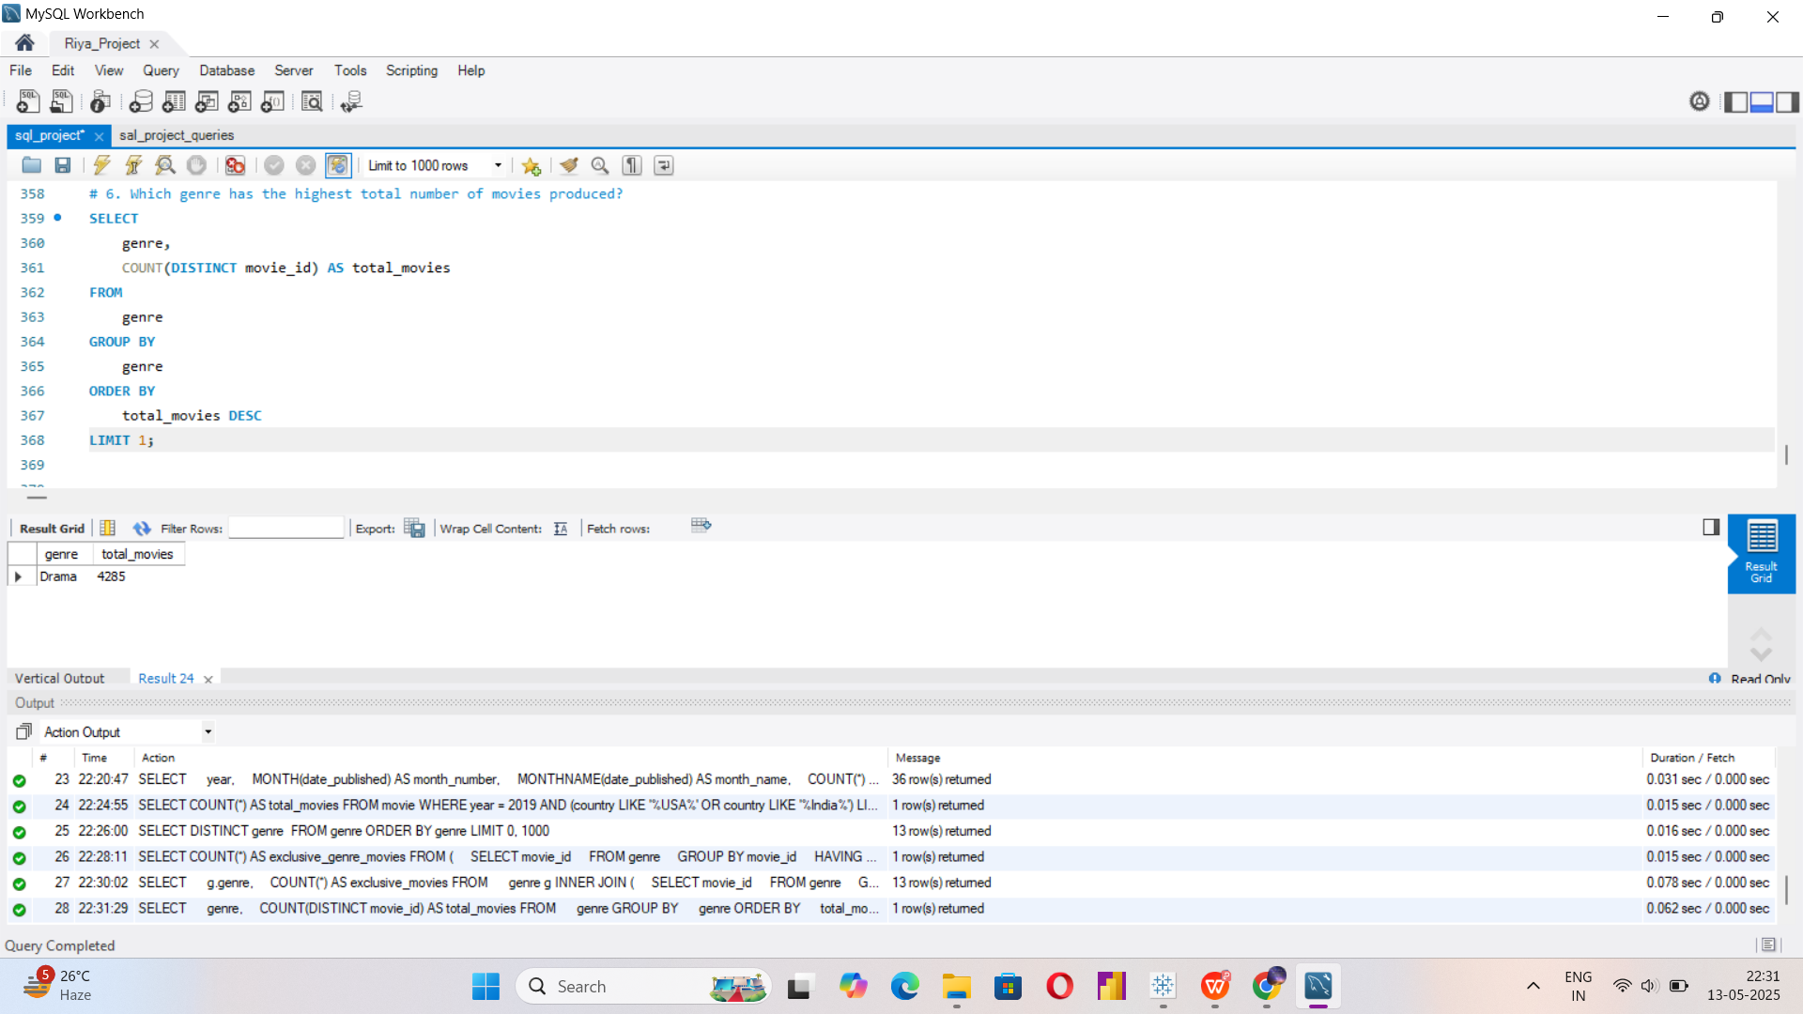

Slide 12
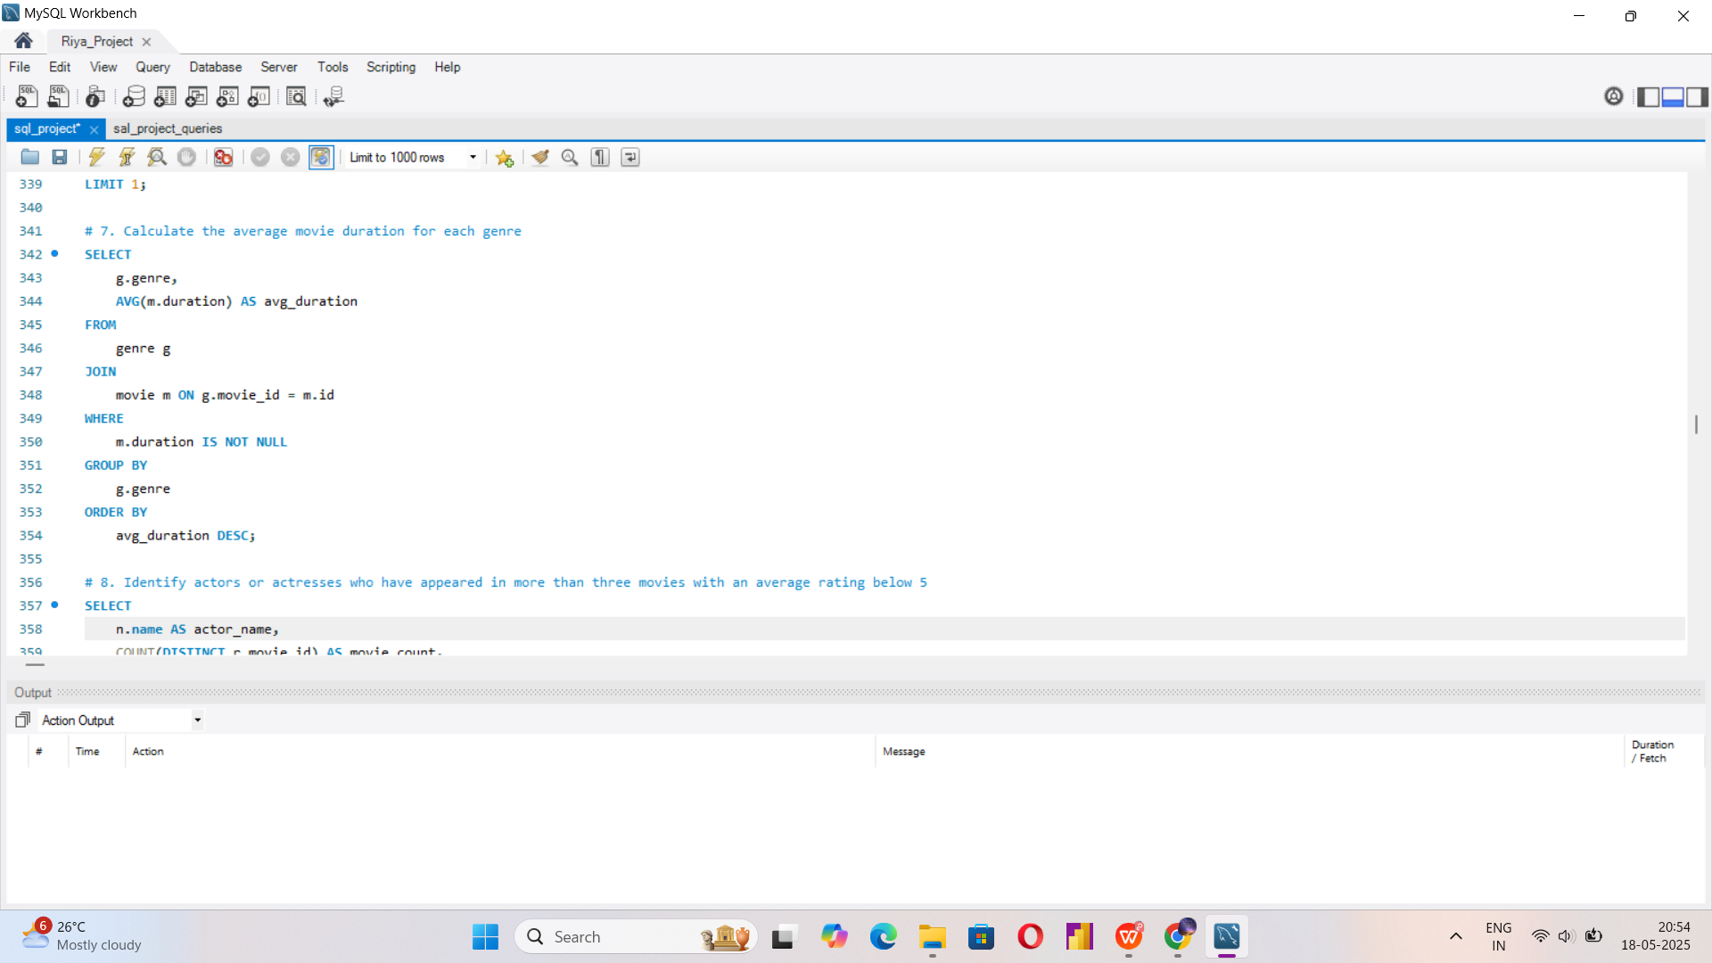
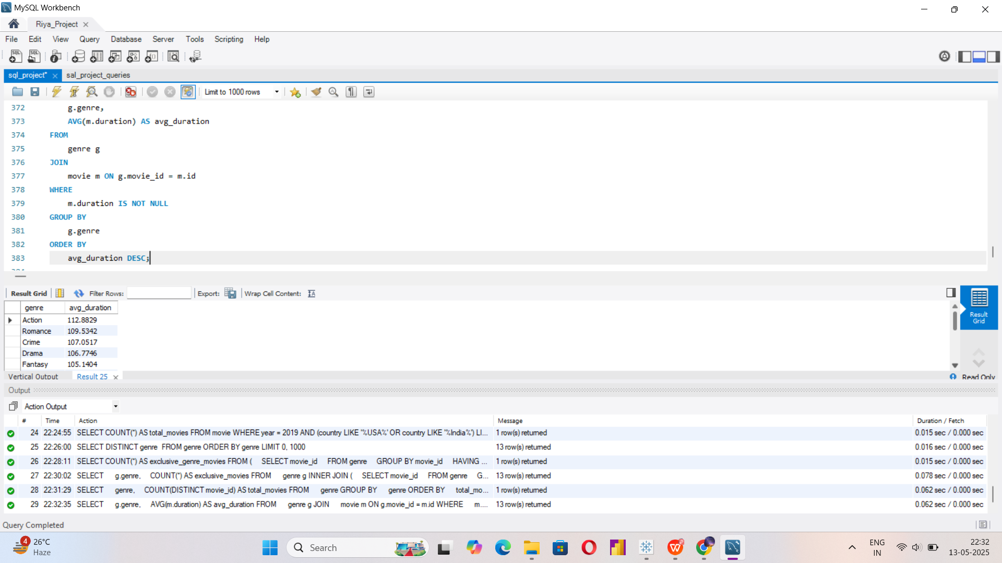
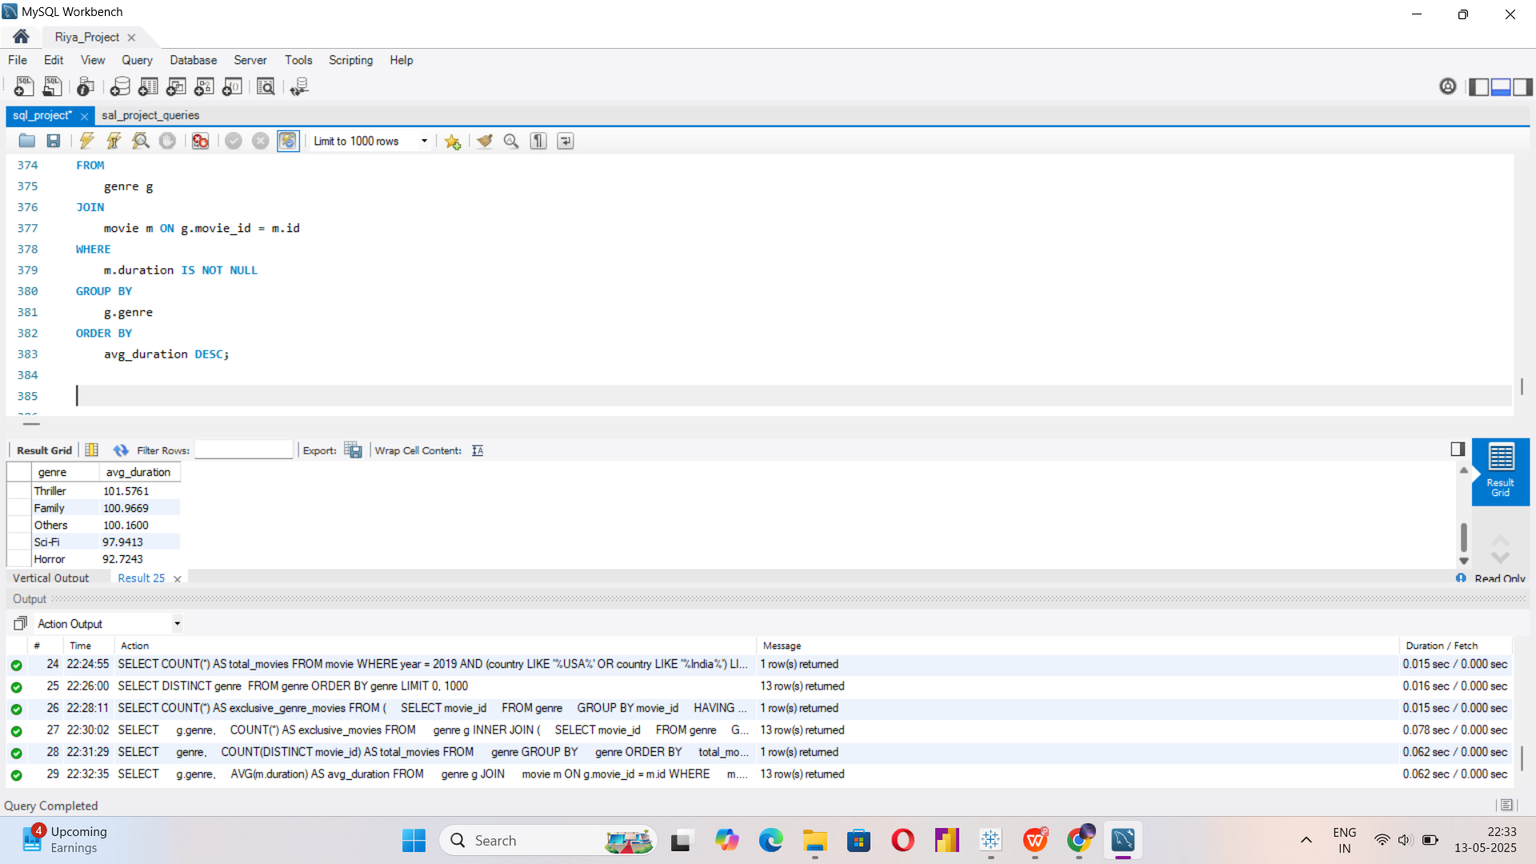

Slide 13
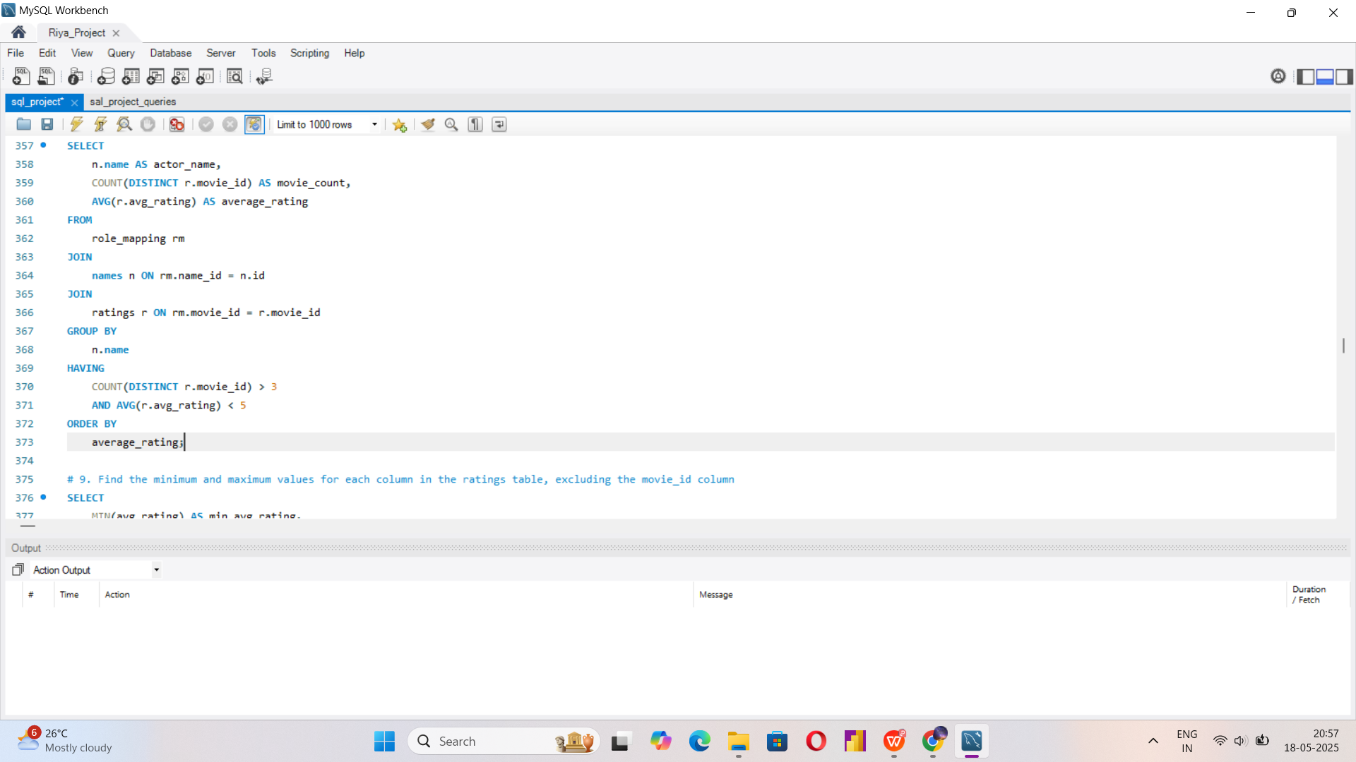
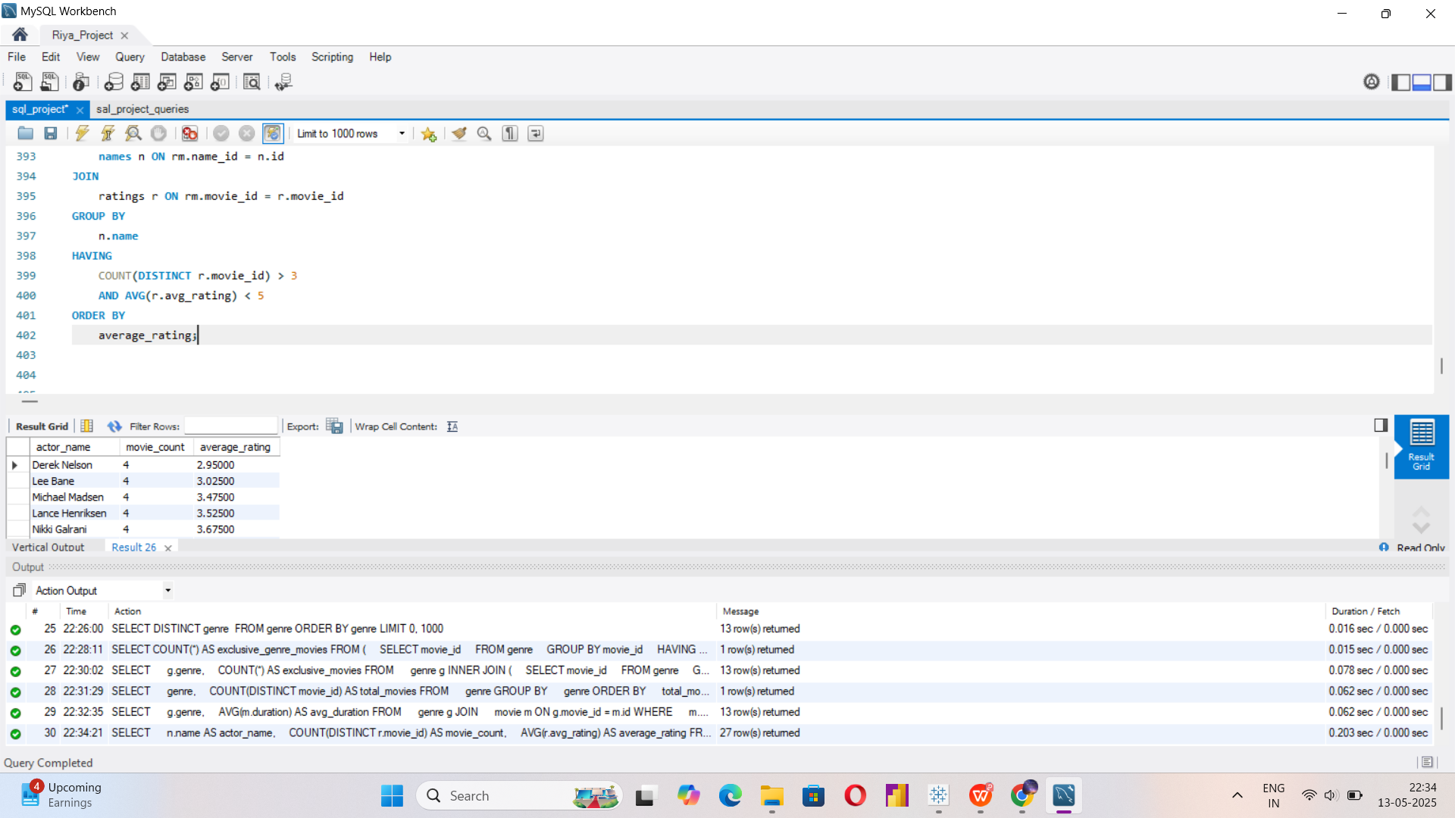

Slide 14
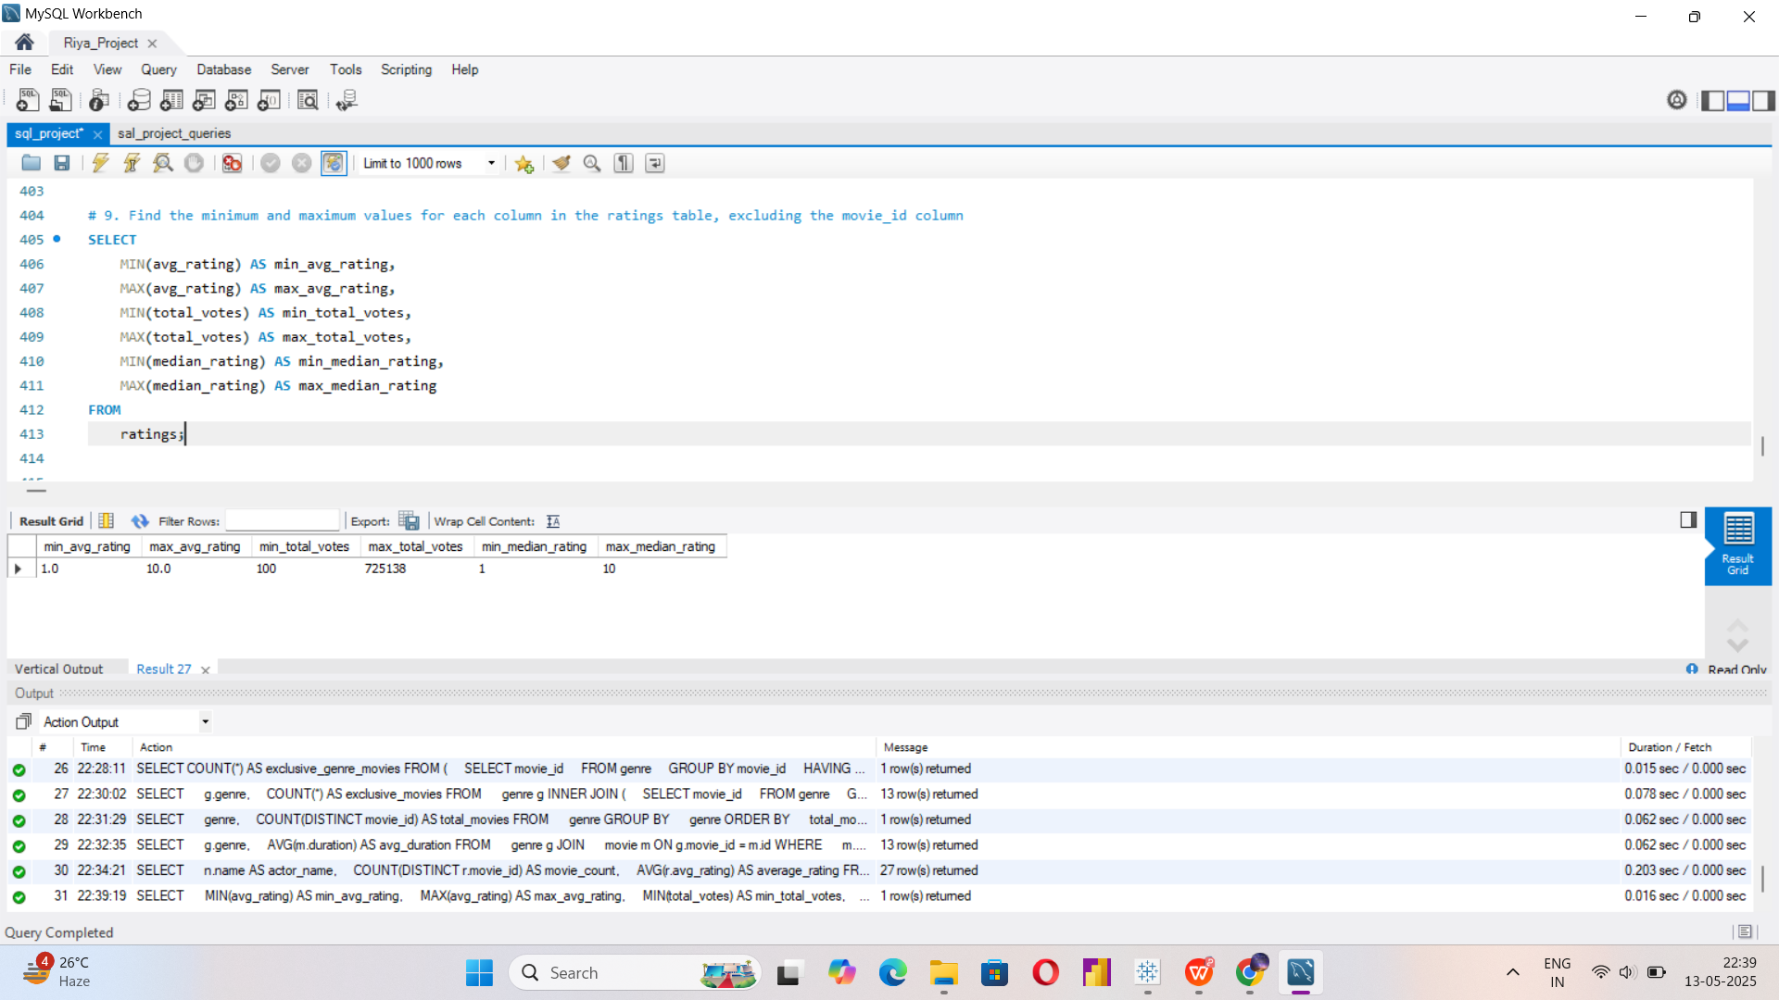

Slide 15
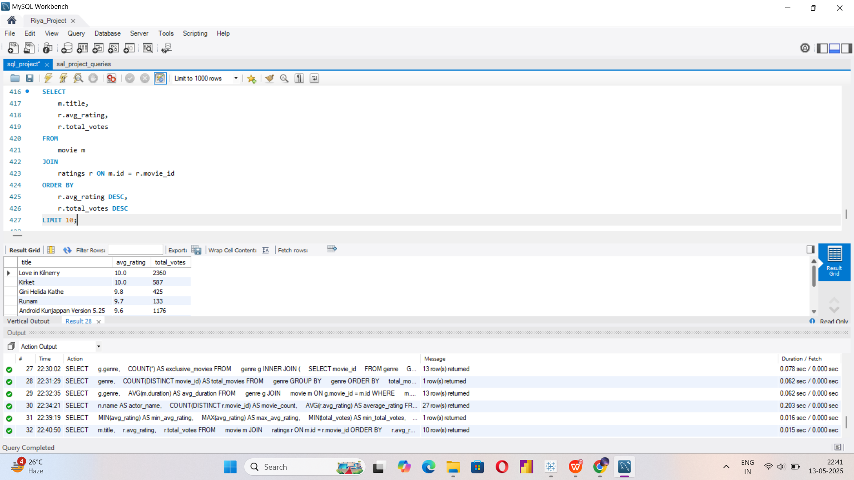

Slide 16
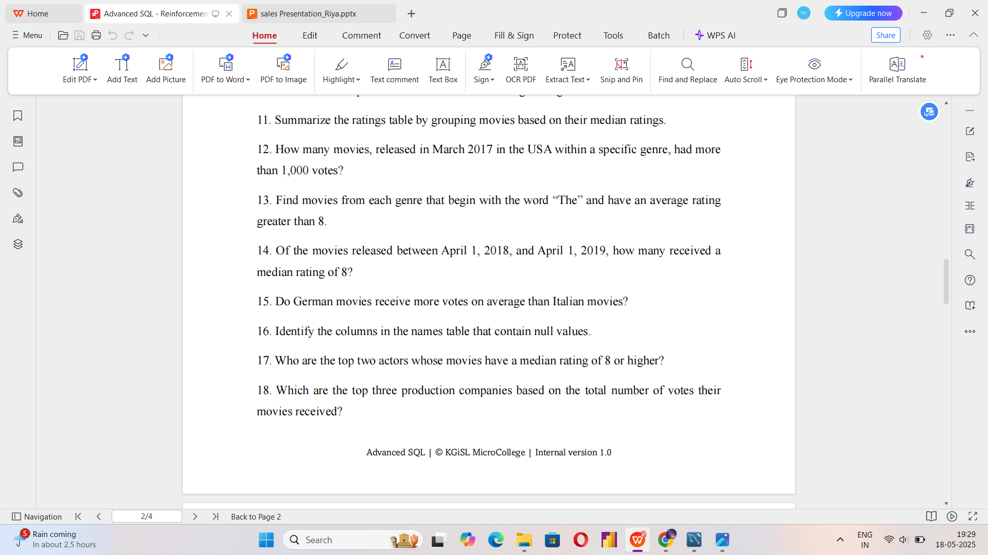
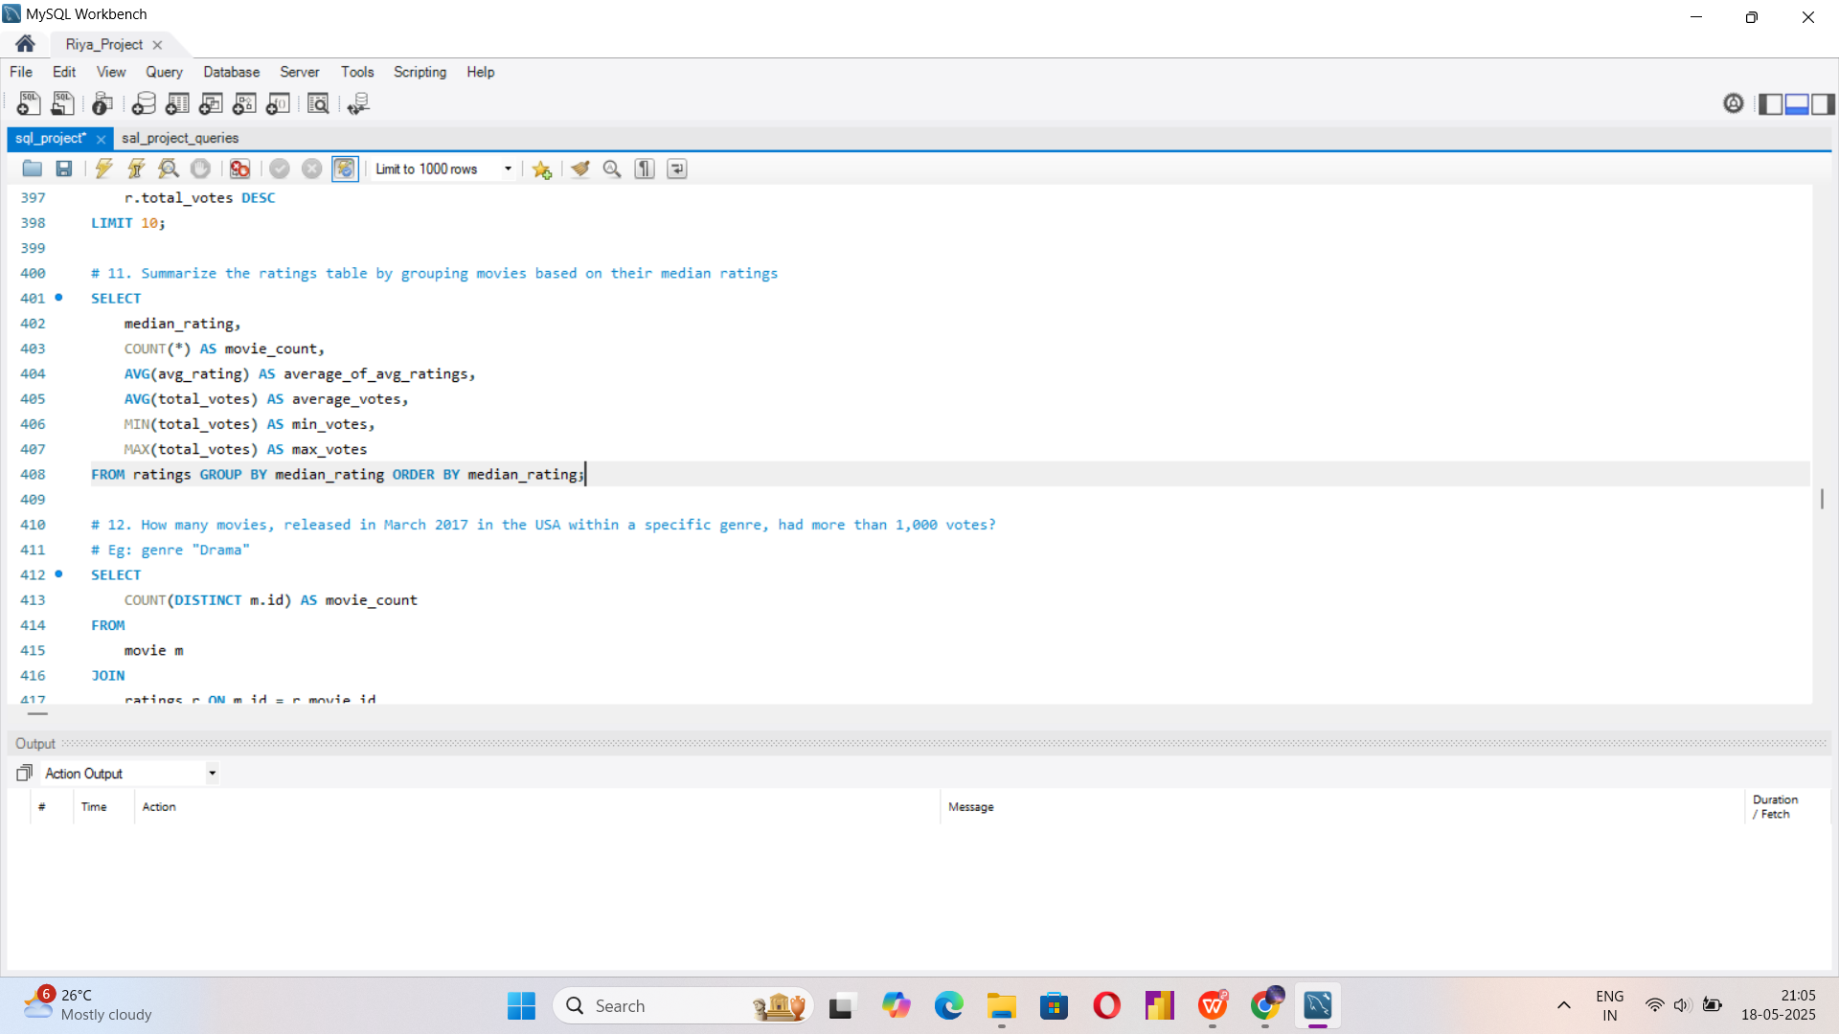
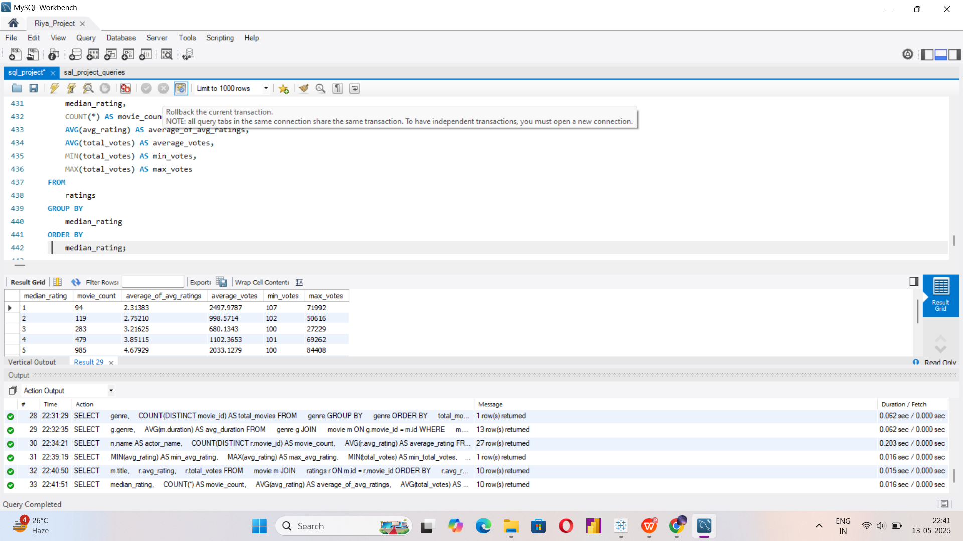

Slide 17
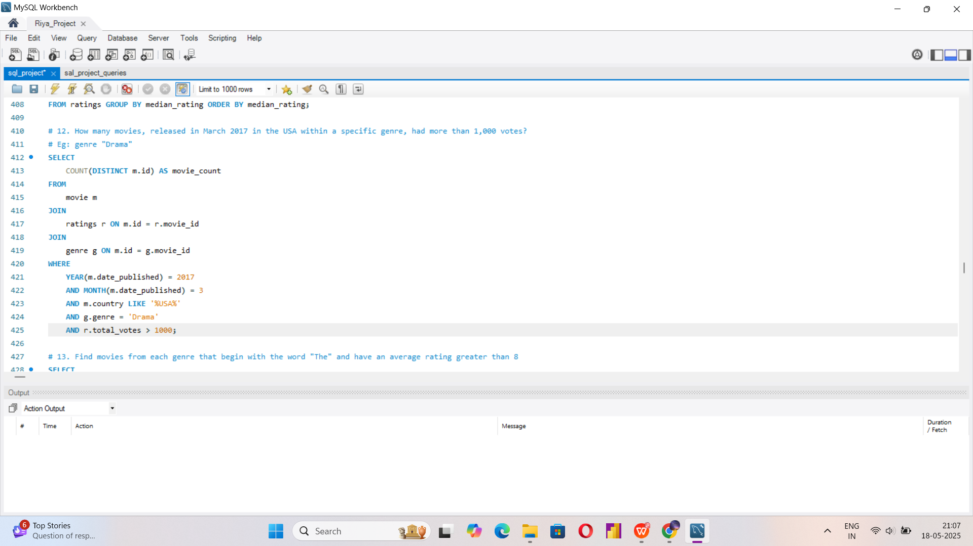
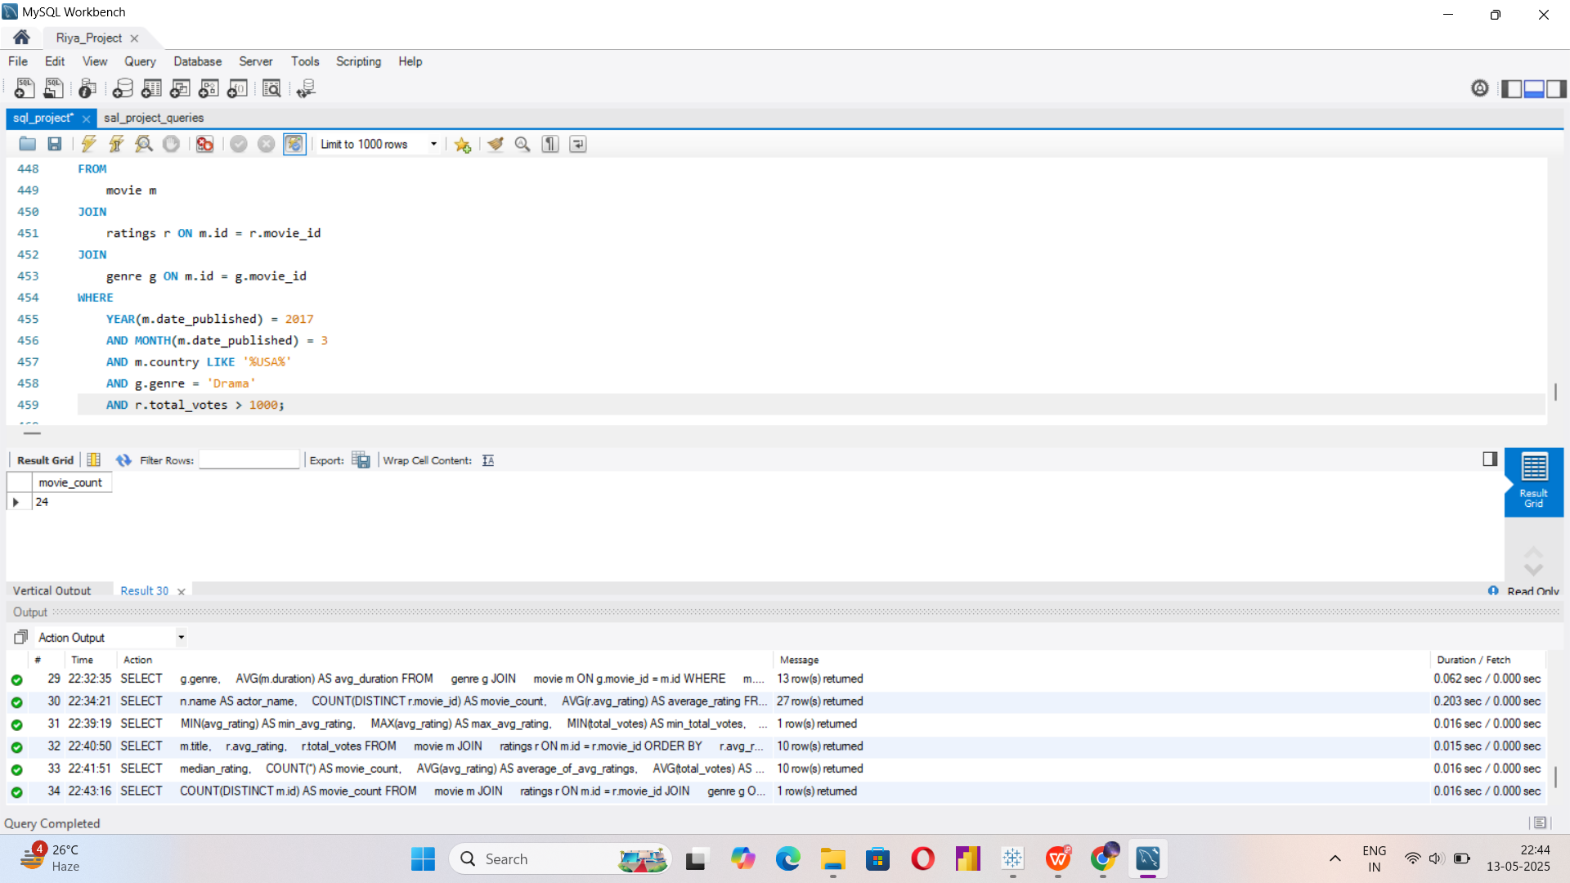

Slide 18
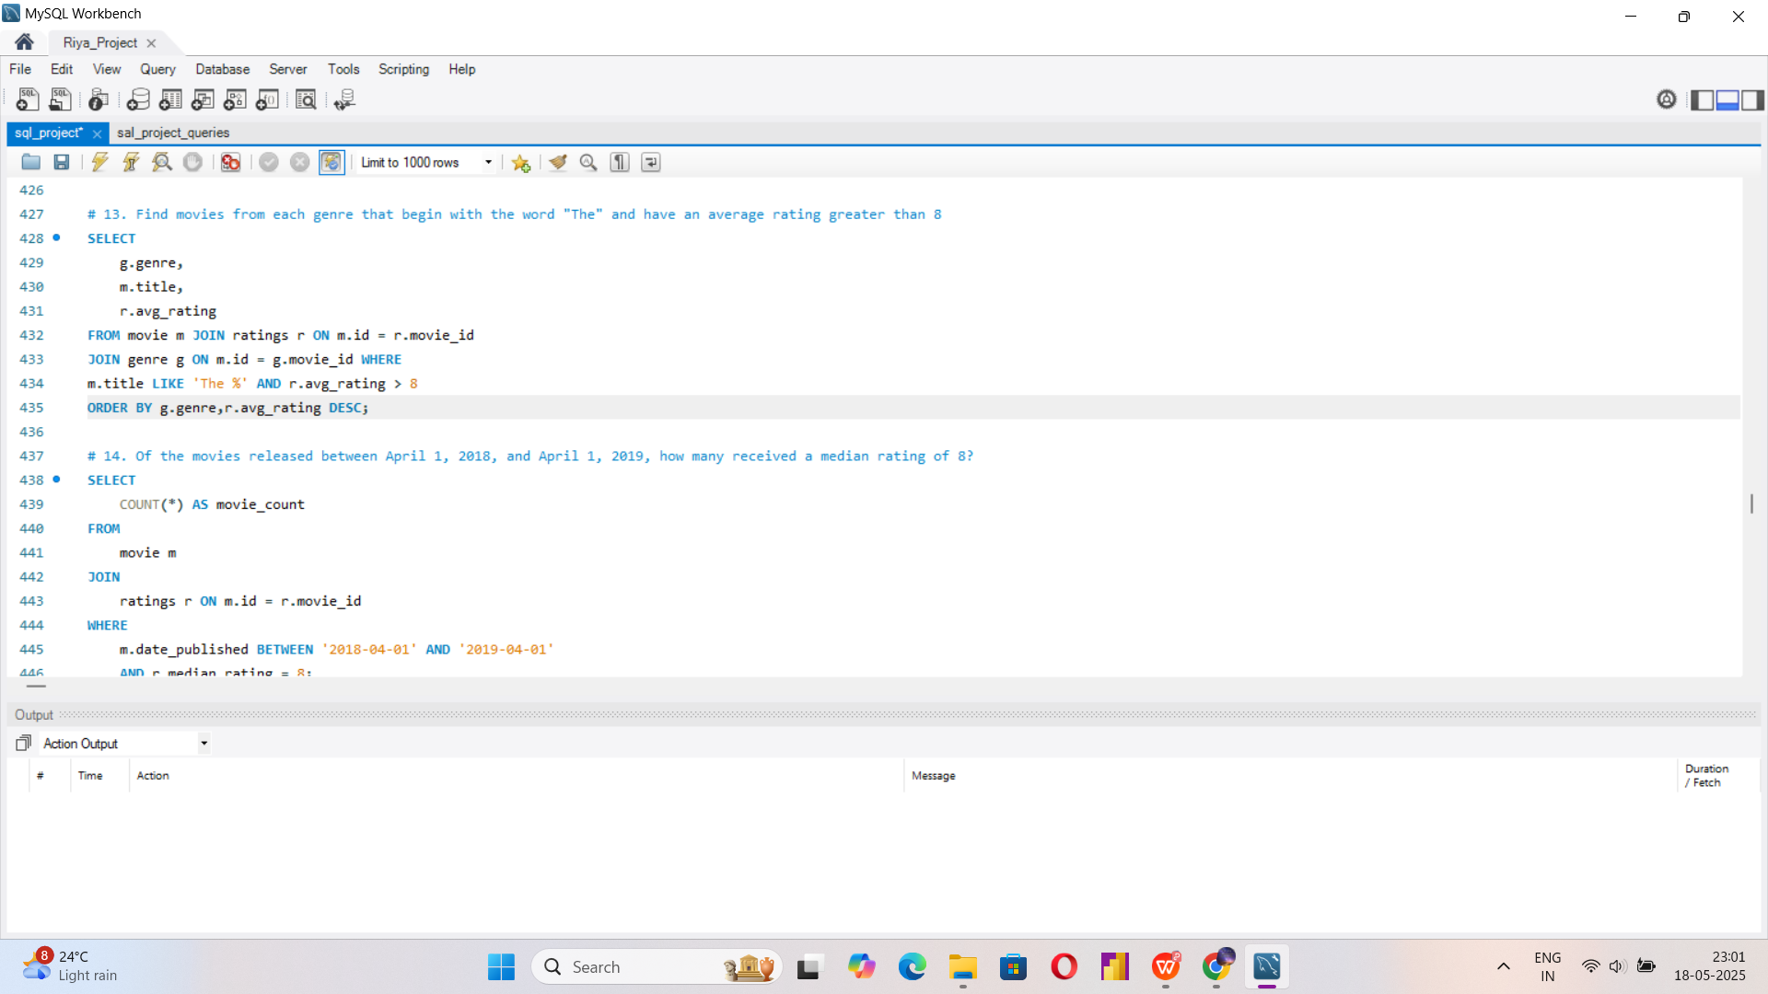
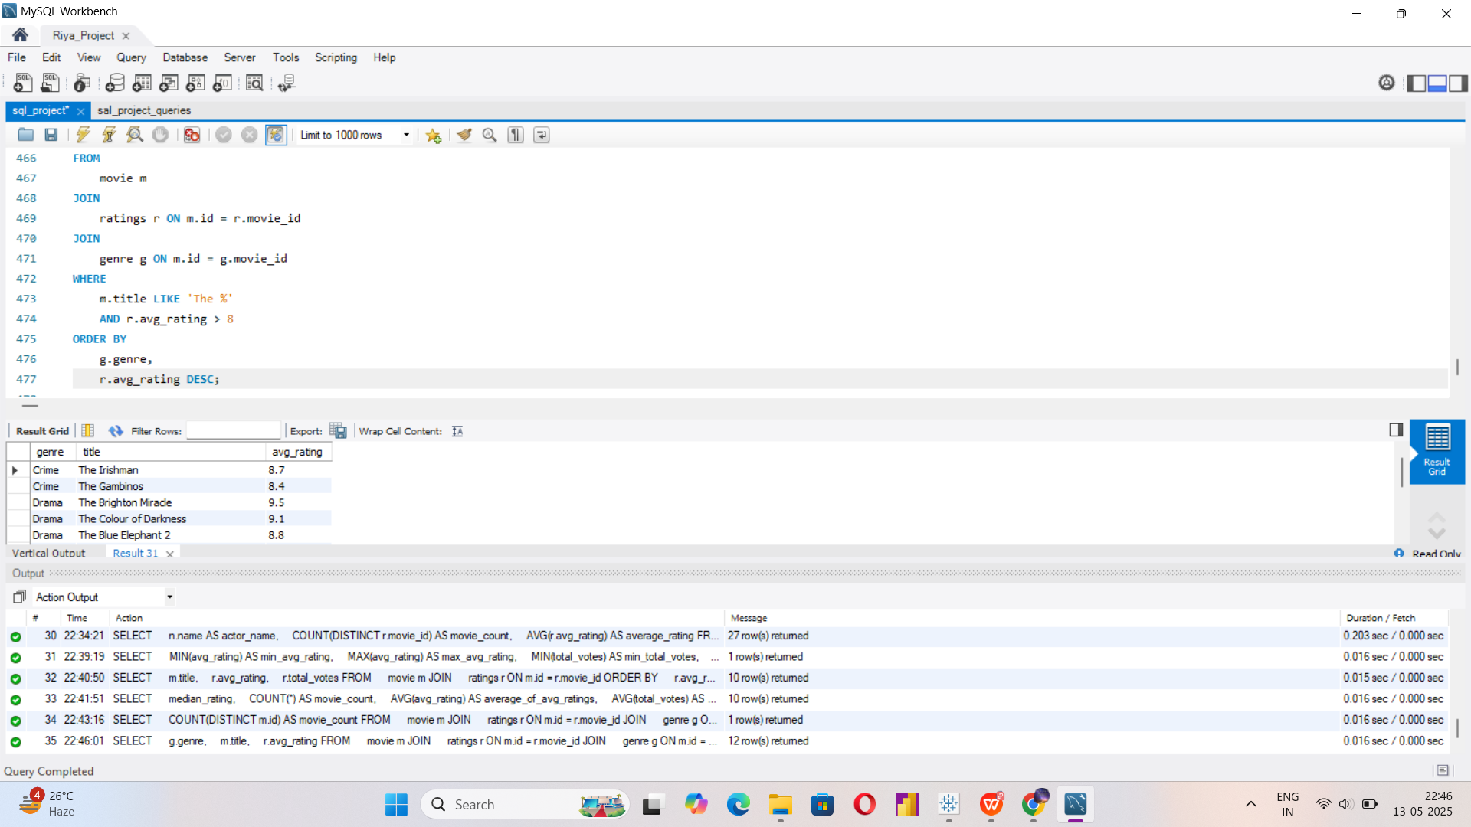

Slide 19
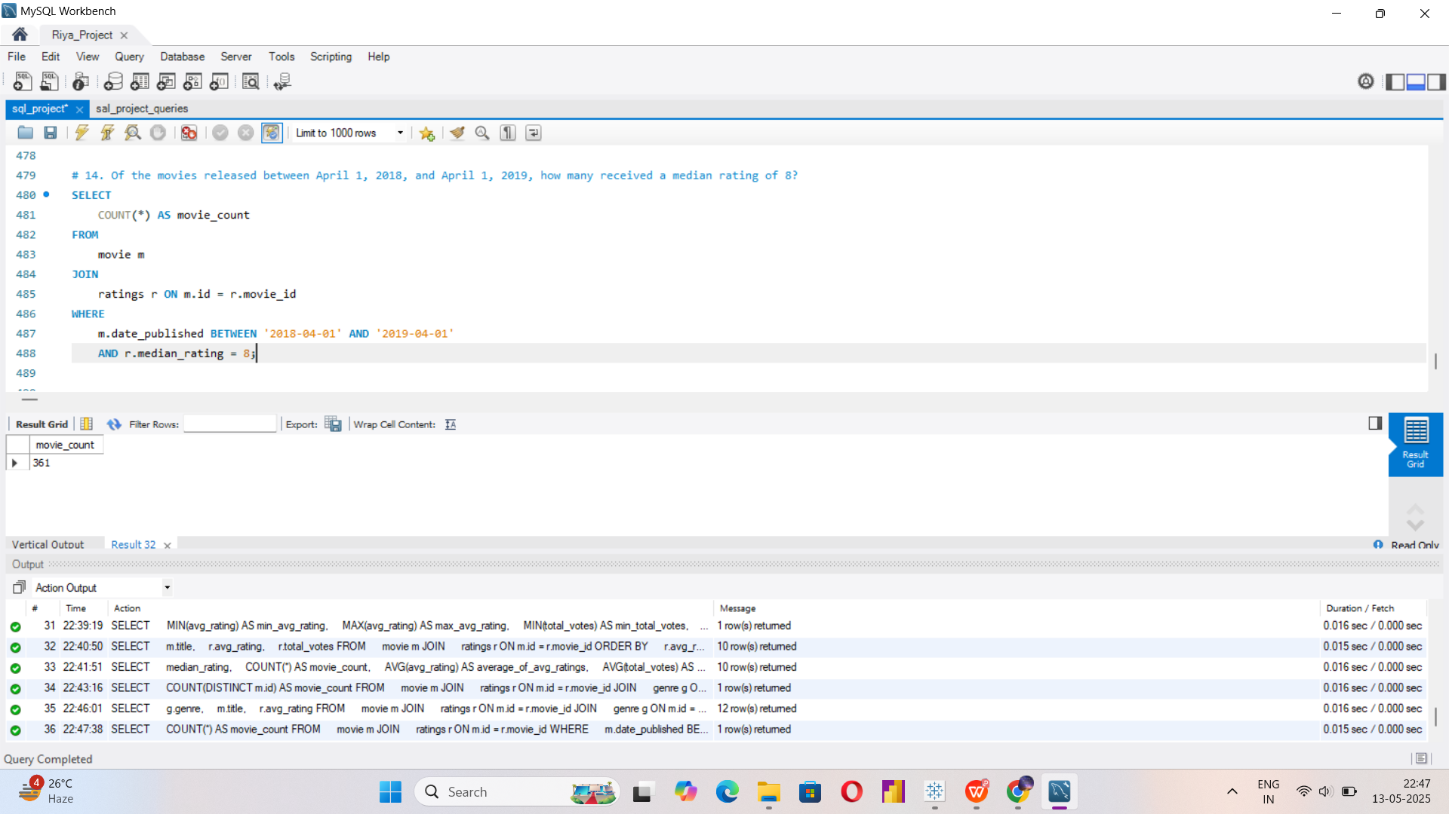

Slide 20
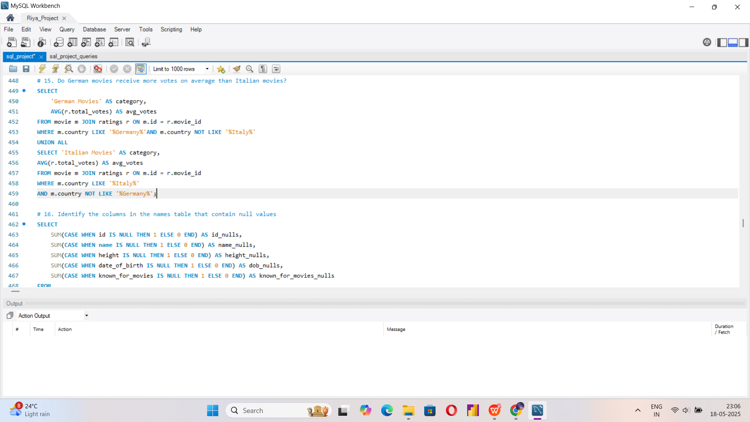
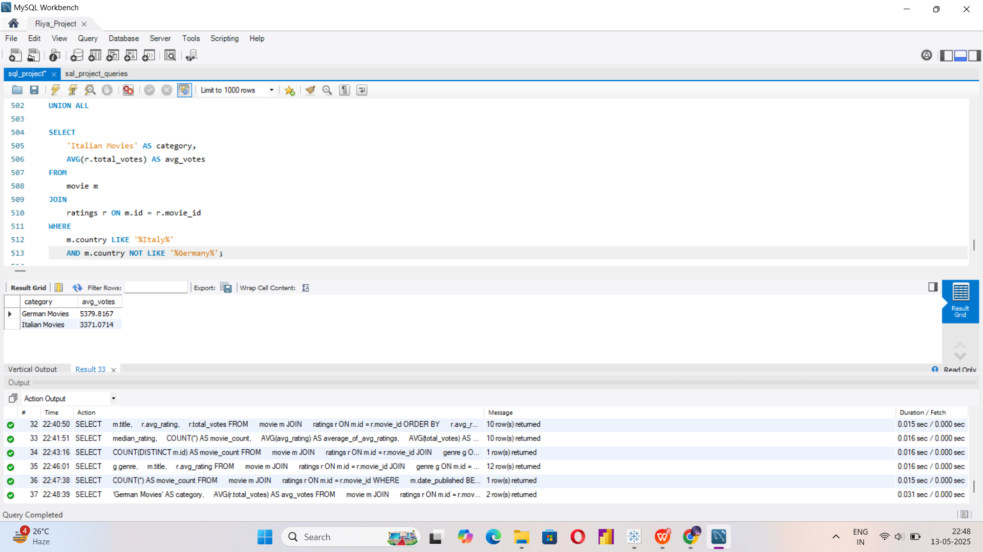

Slide 21
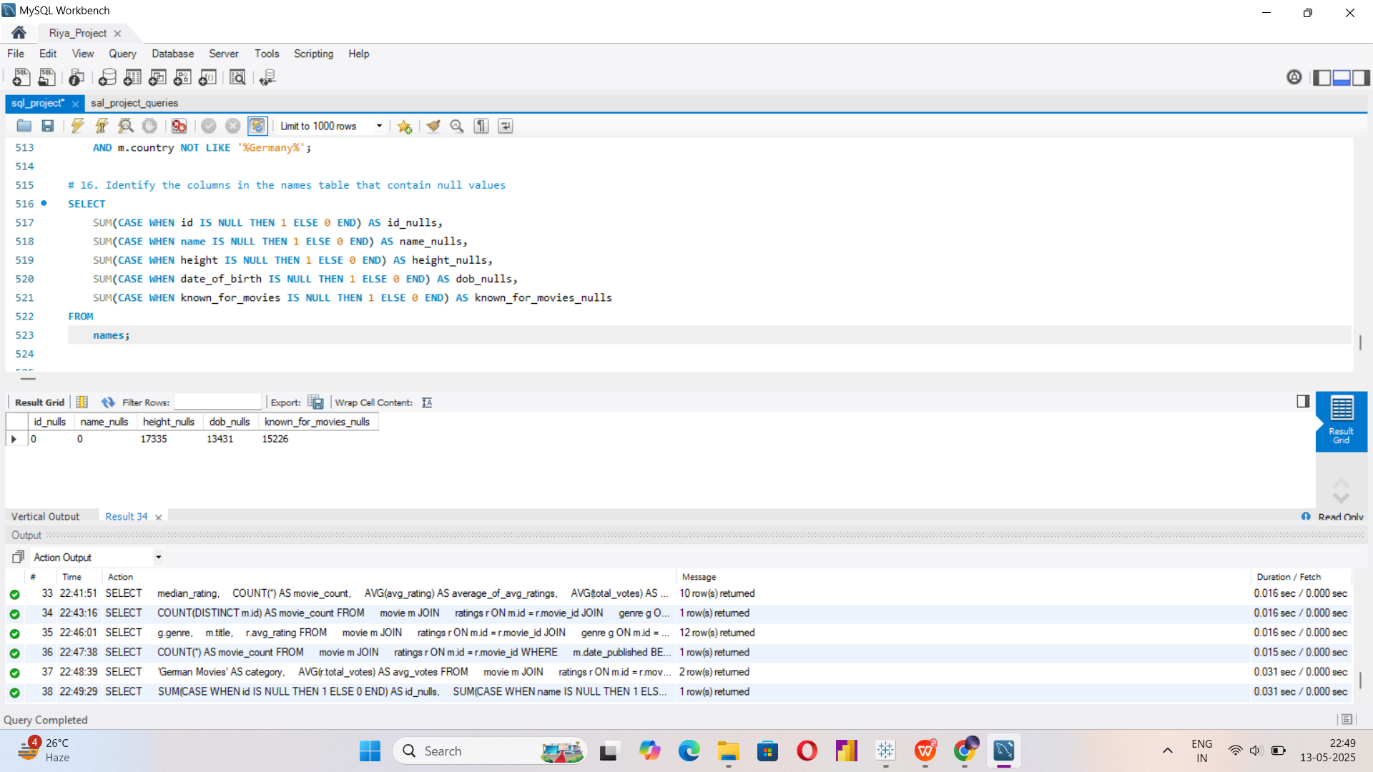
QUERIES PERFORMED:

Slide 22
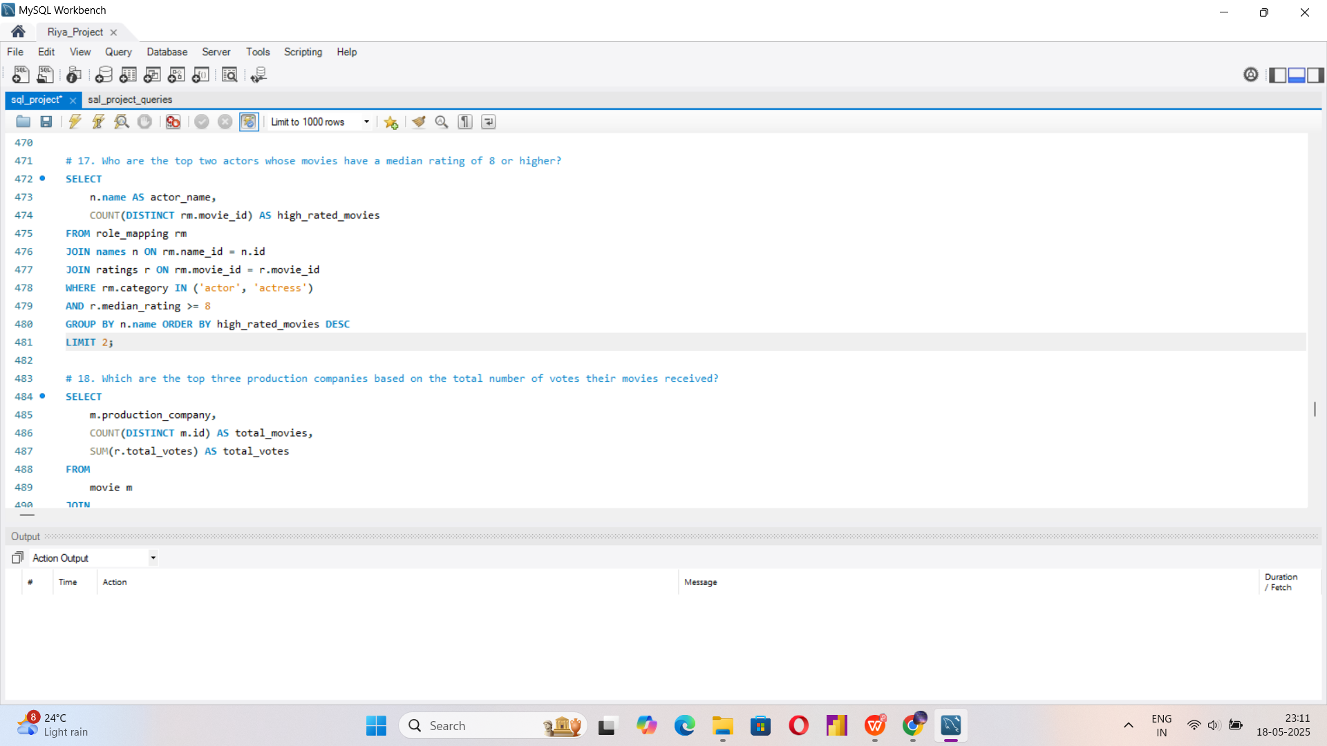
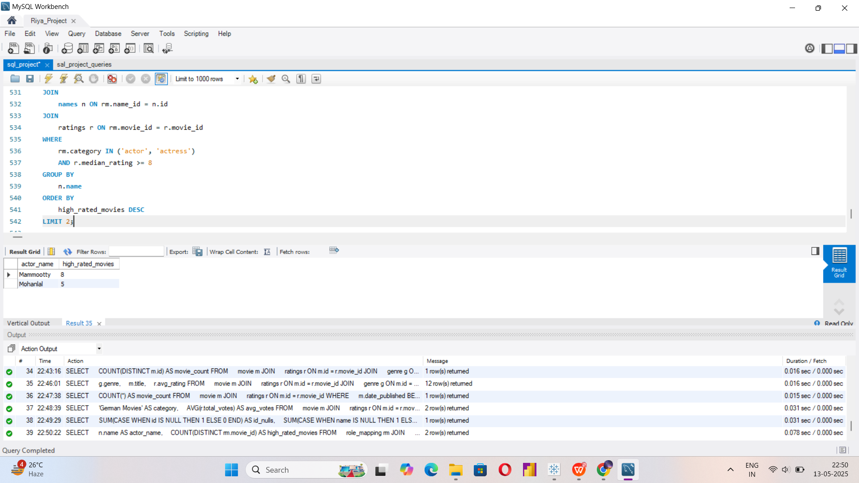

Slide 23
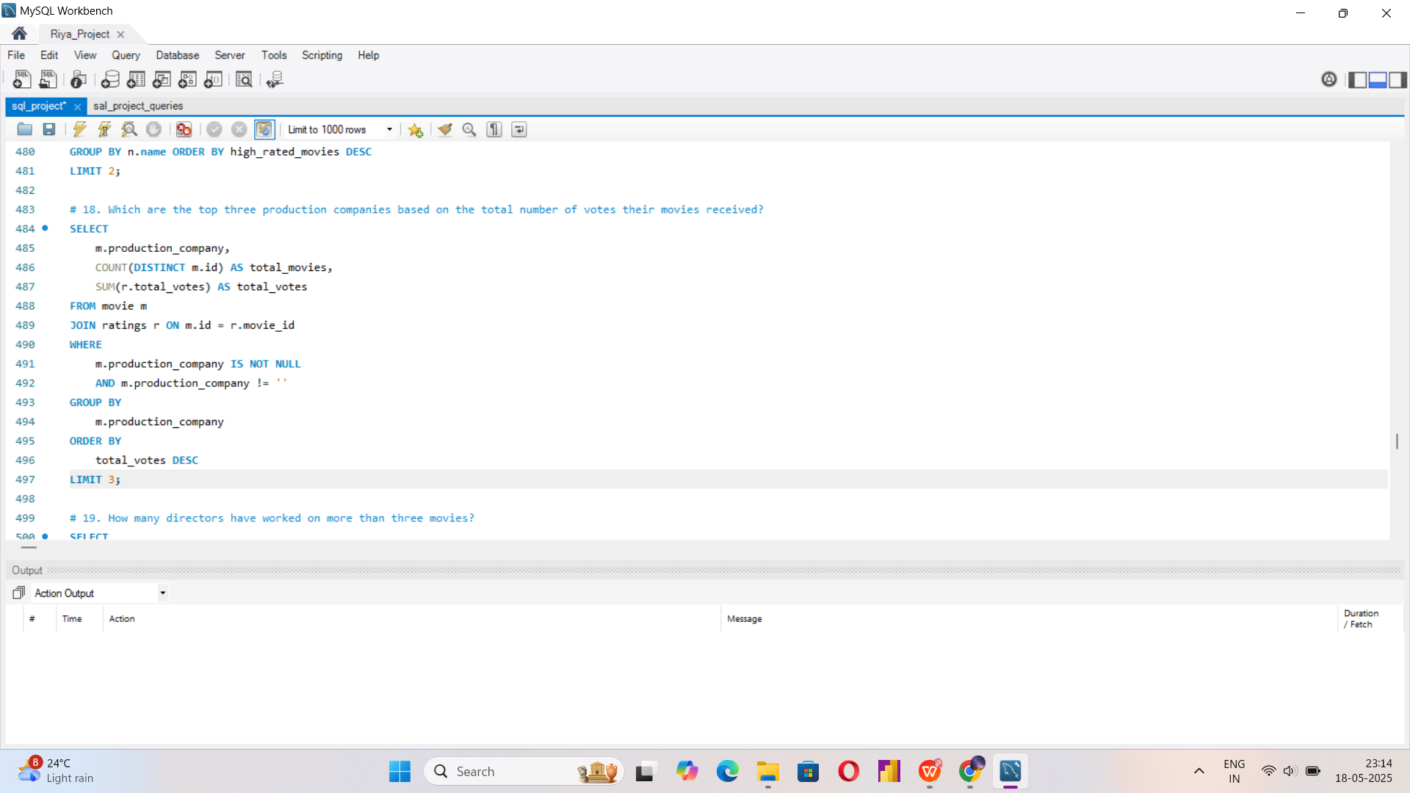
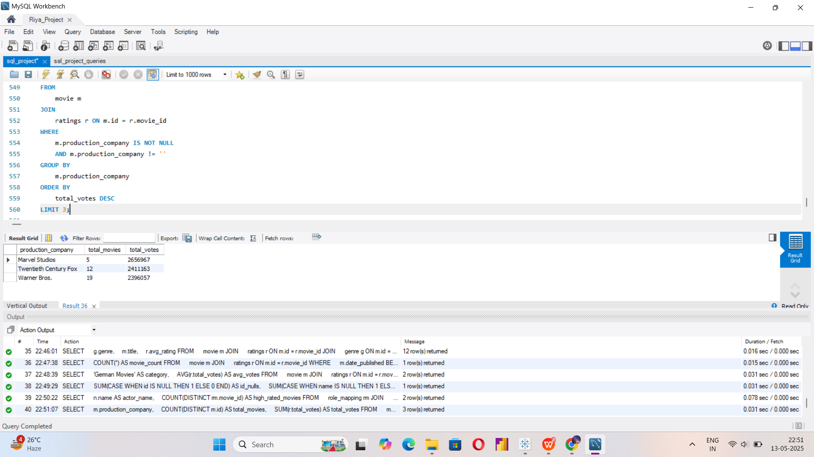

Slide 24
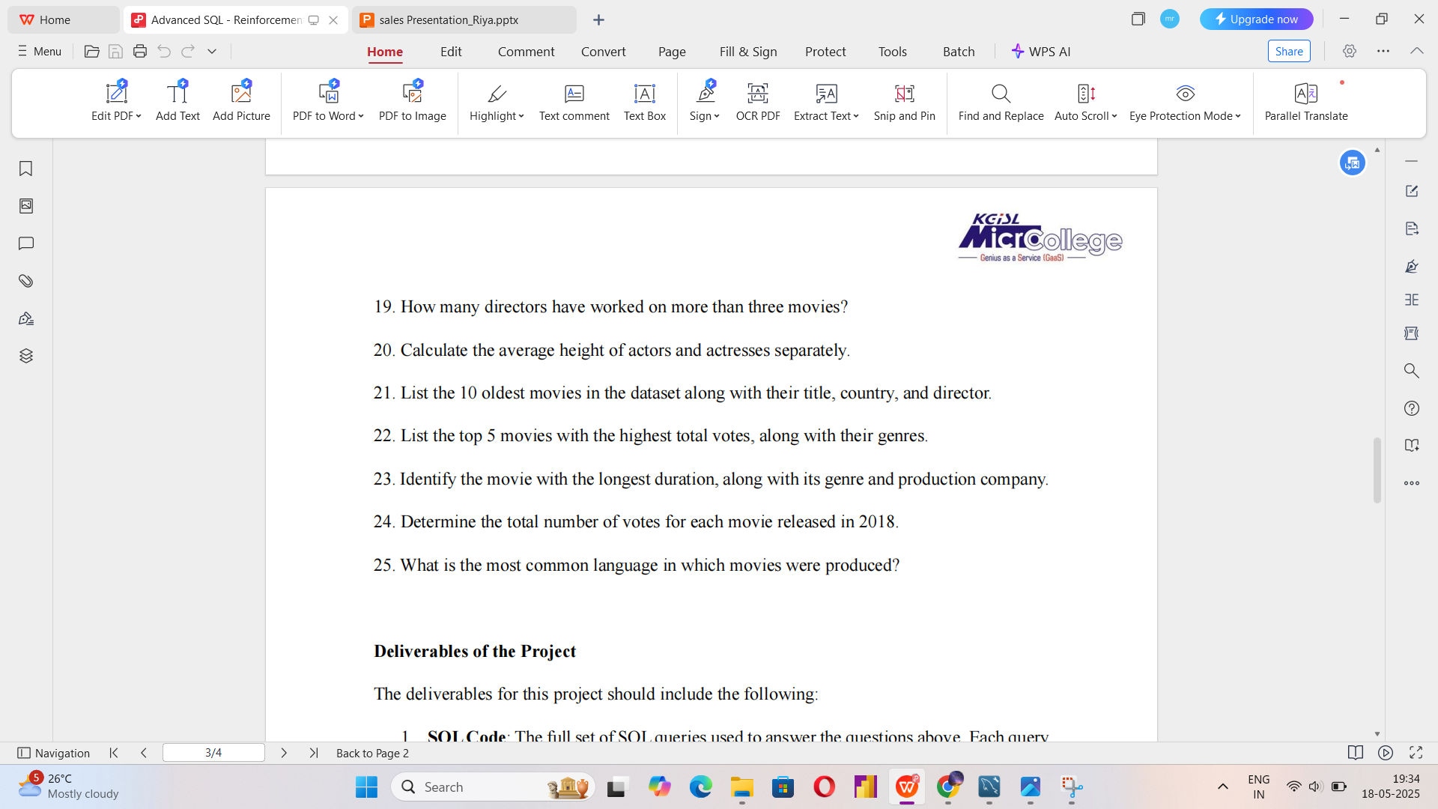
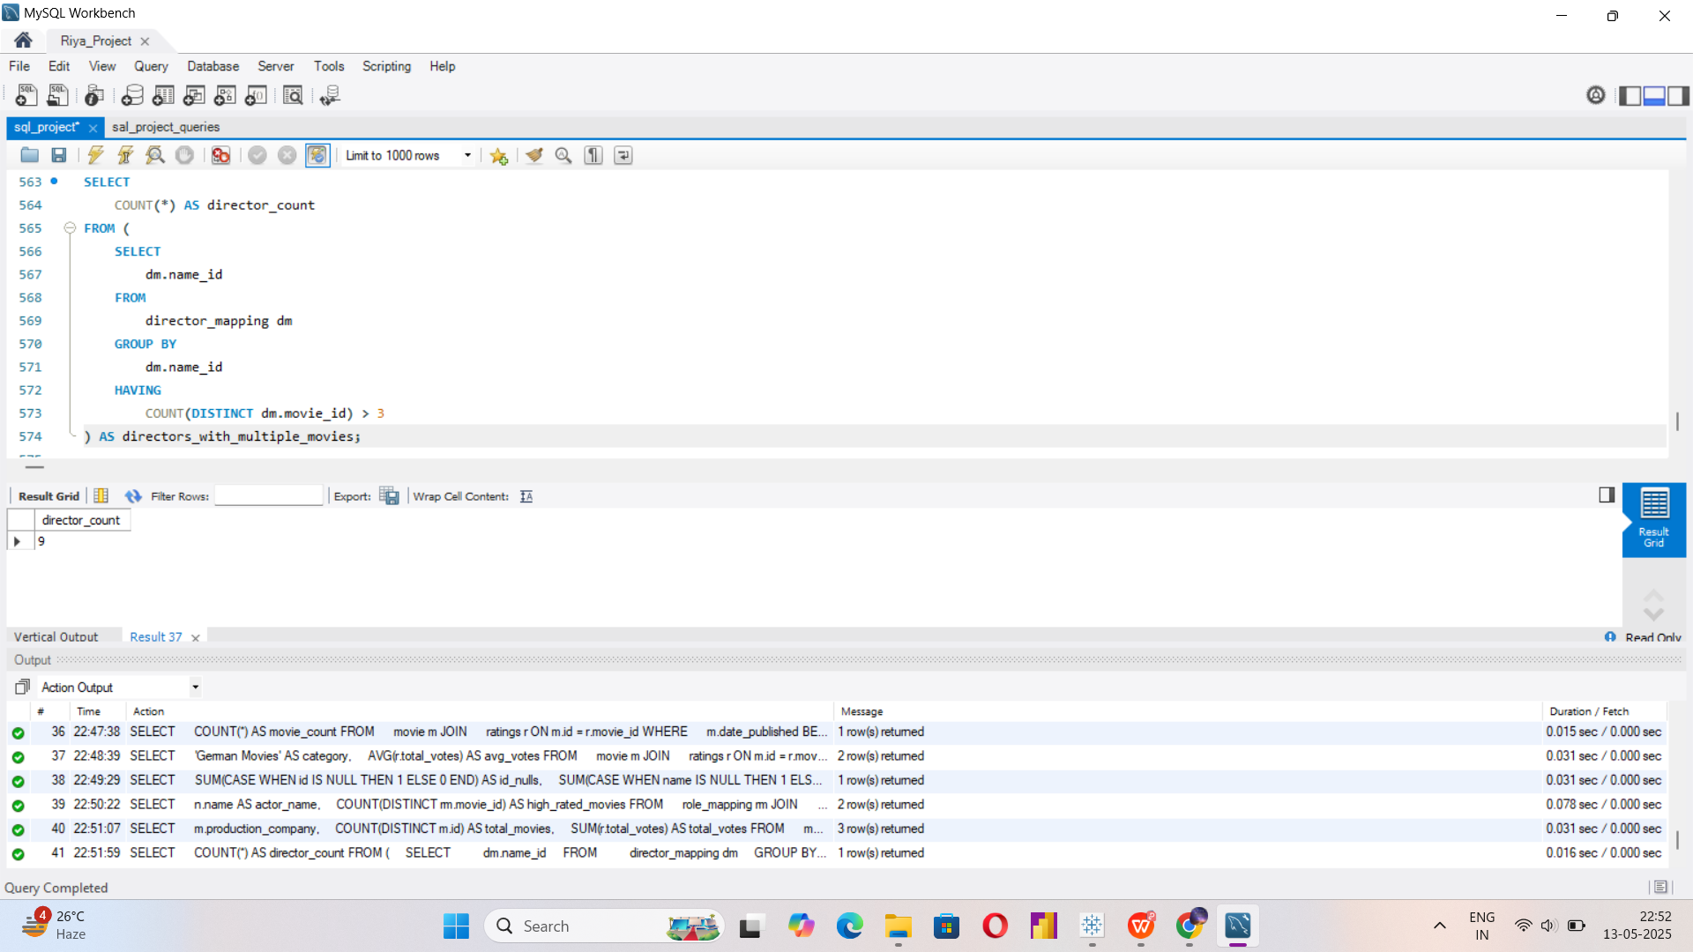

Slide 25


Slide 26
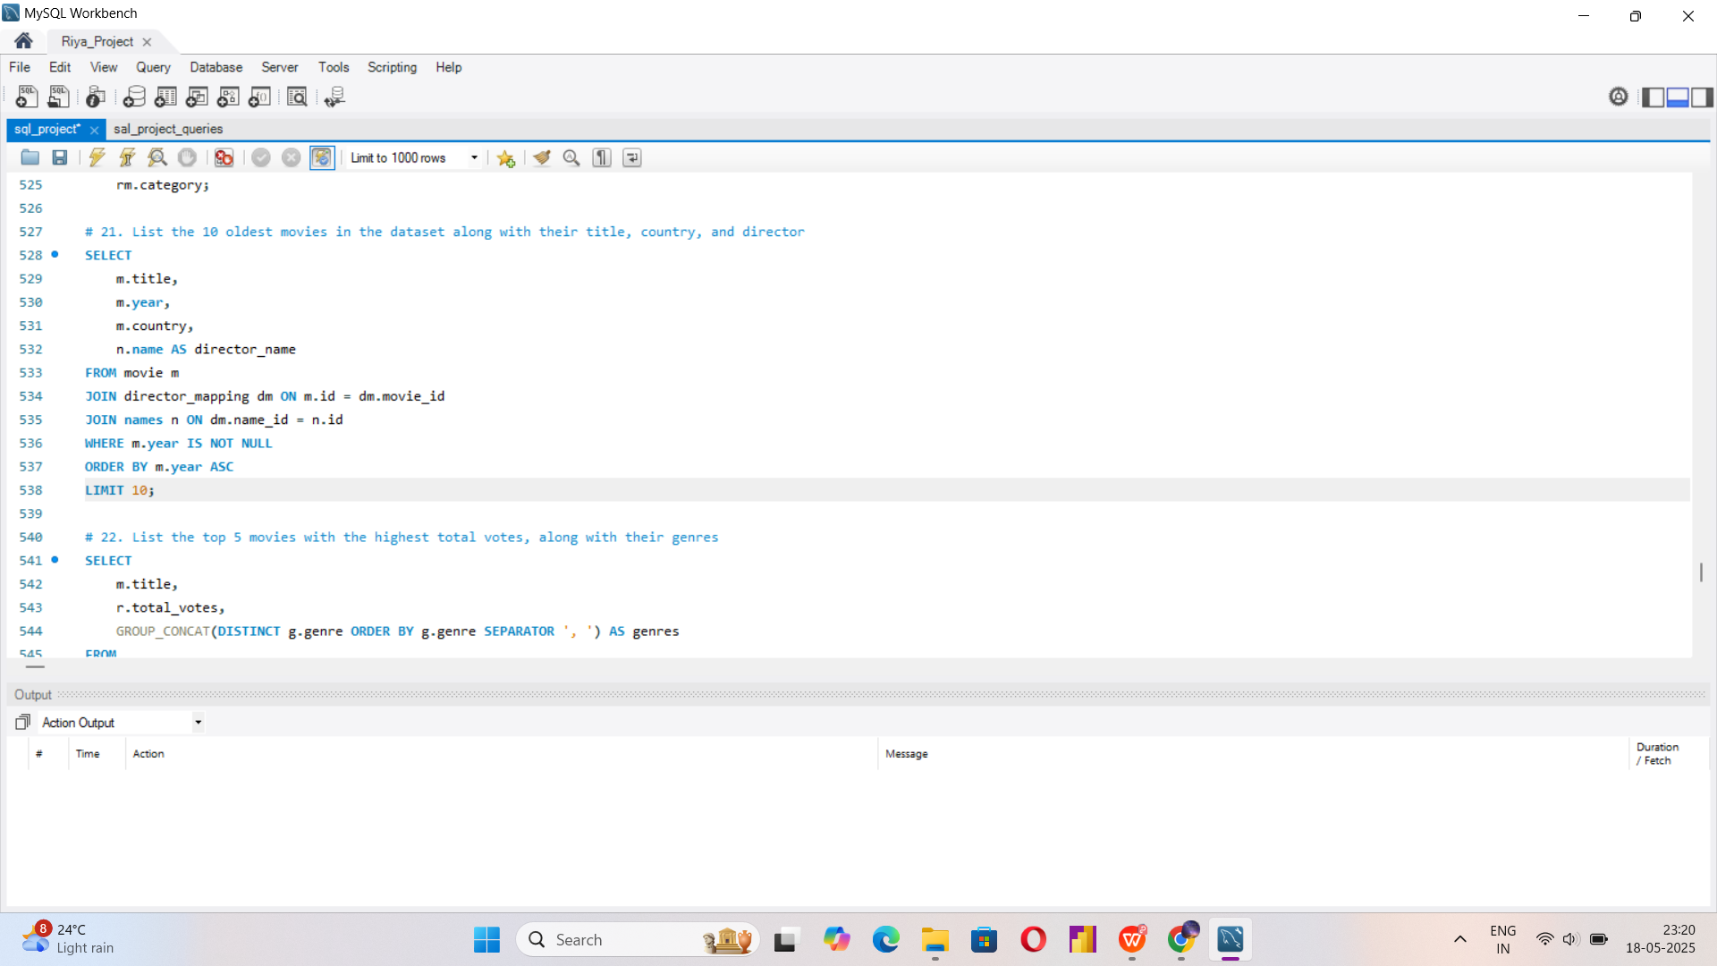
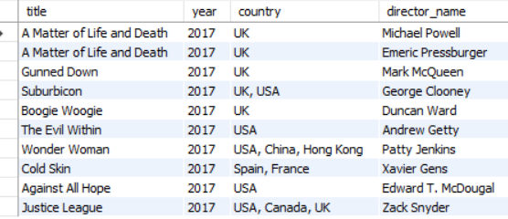

Slide 27
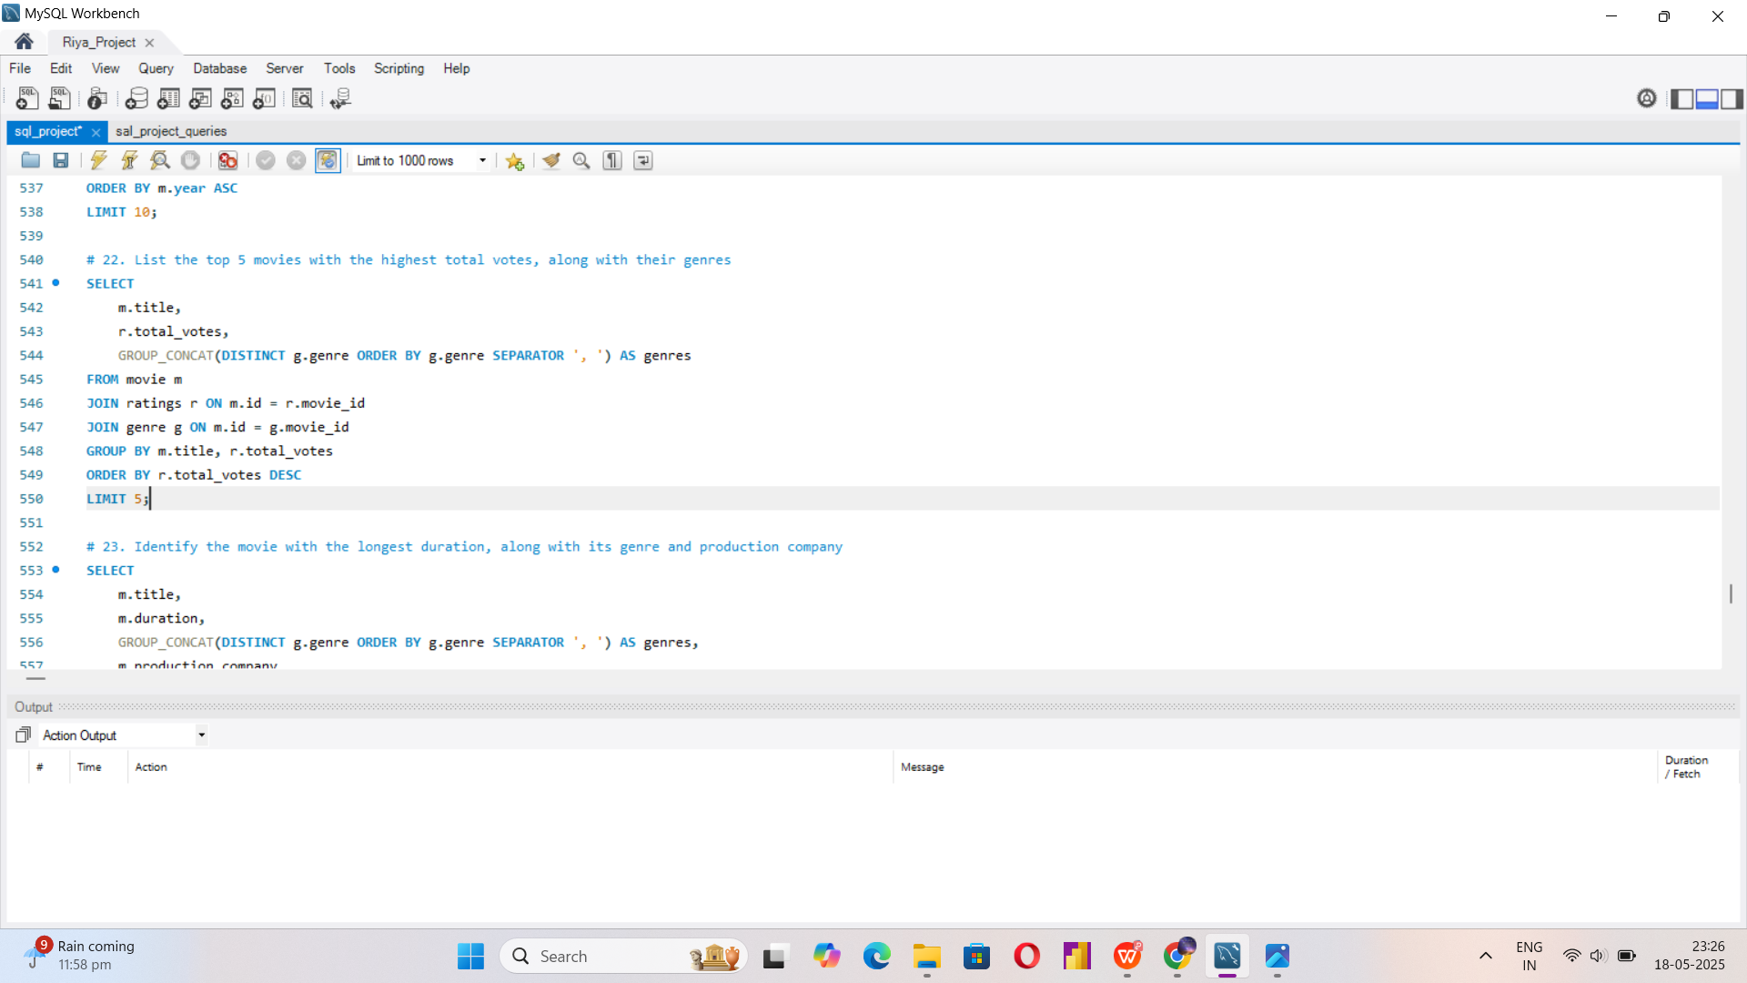
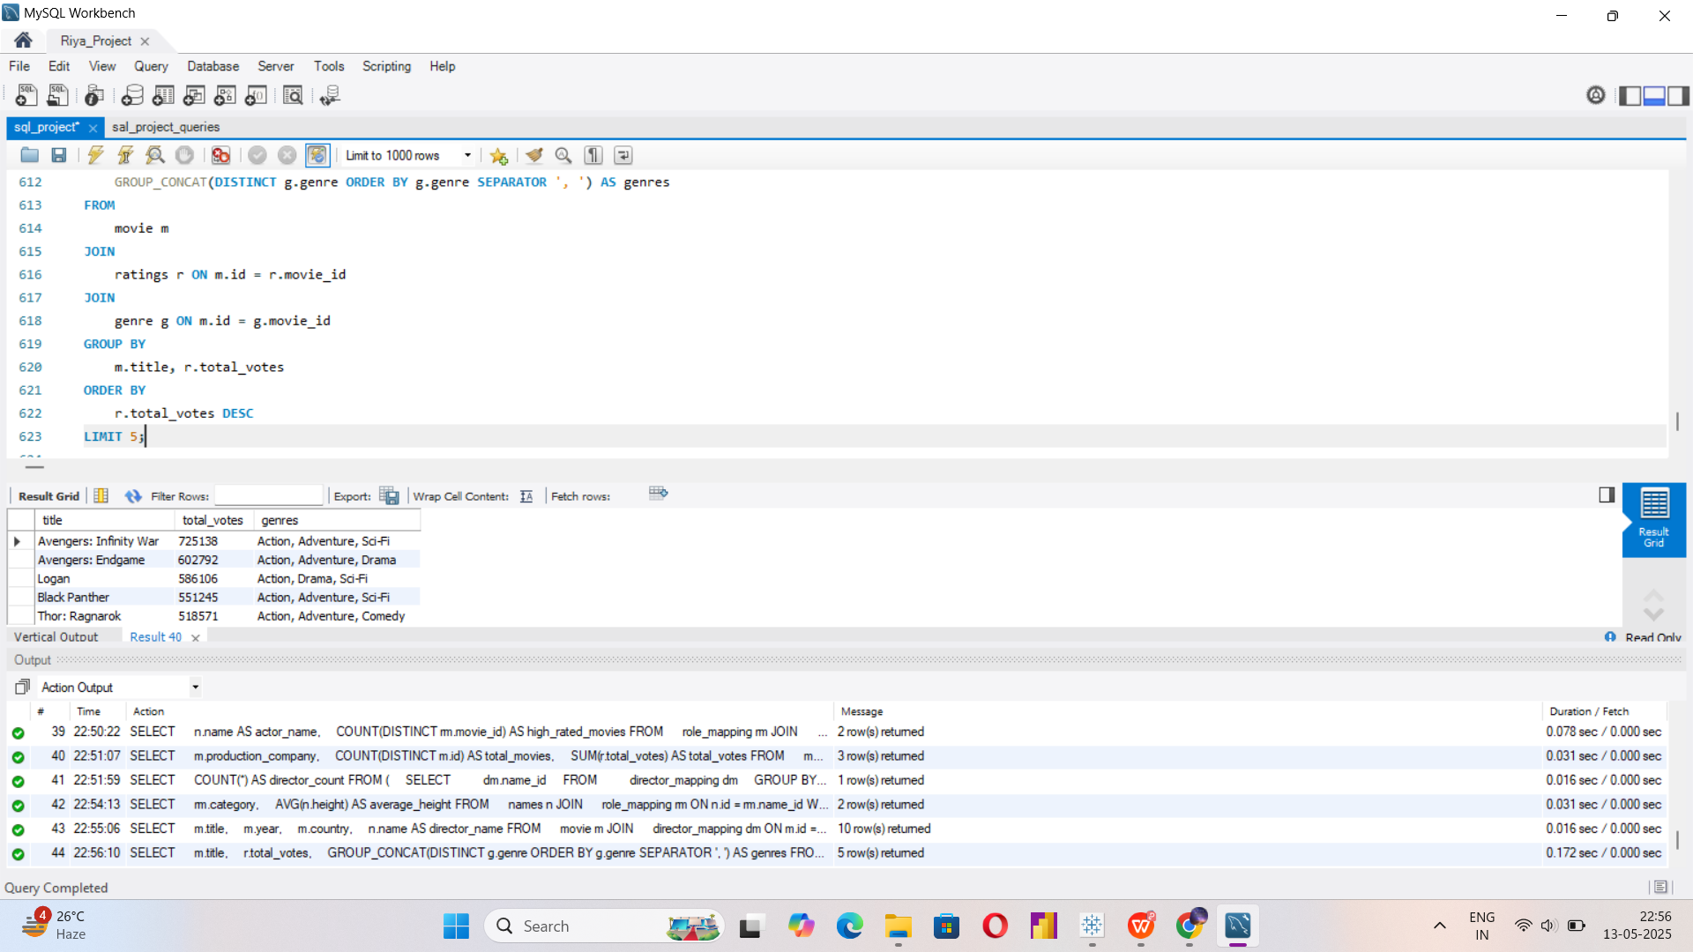

Slide 28
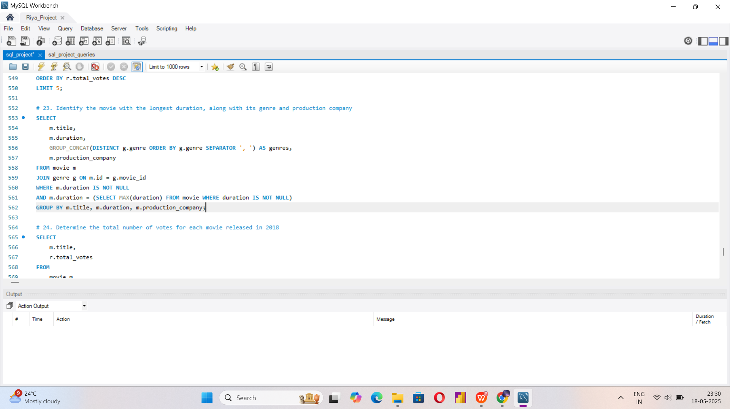


Slide 29
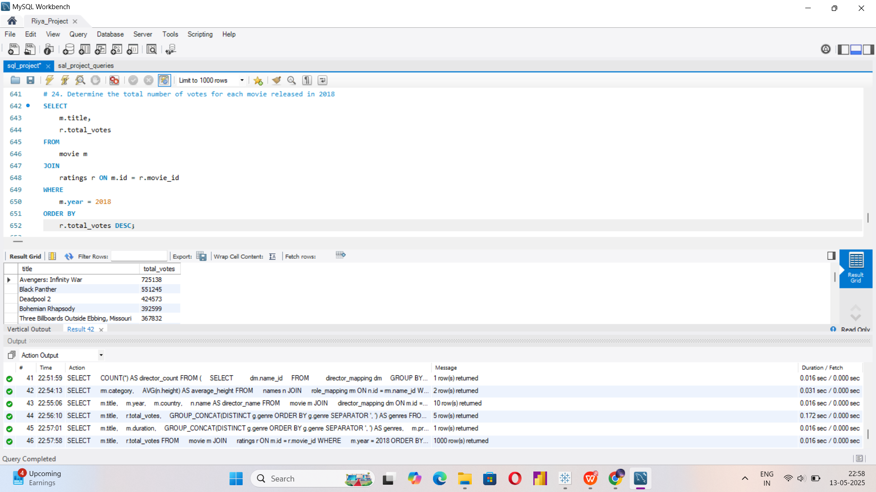

Slide 30
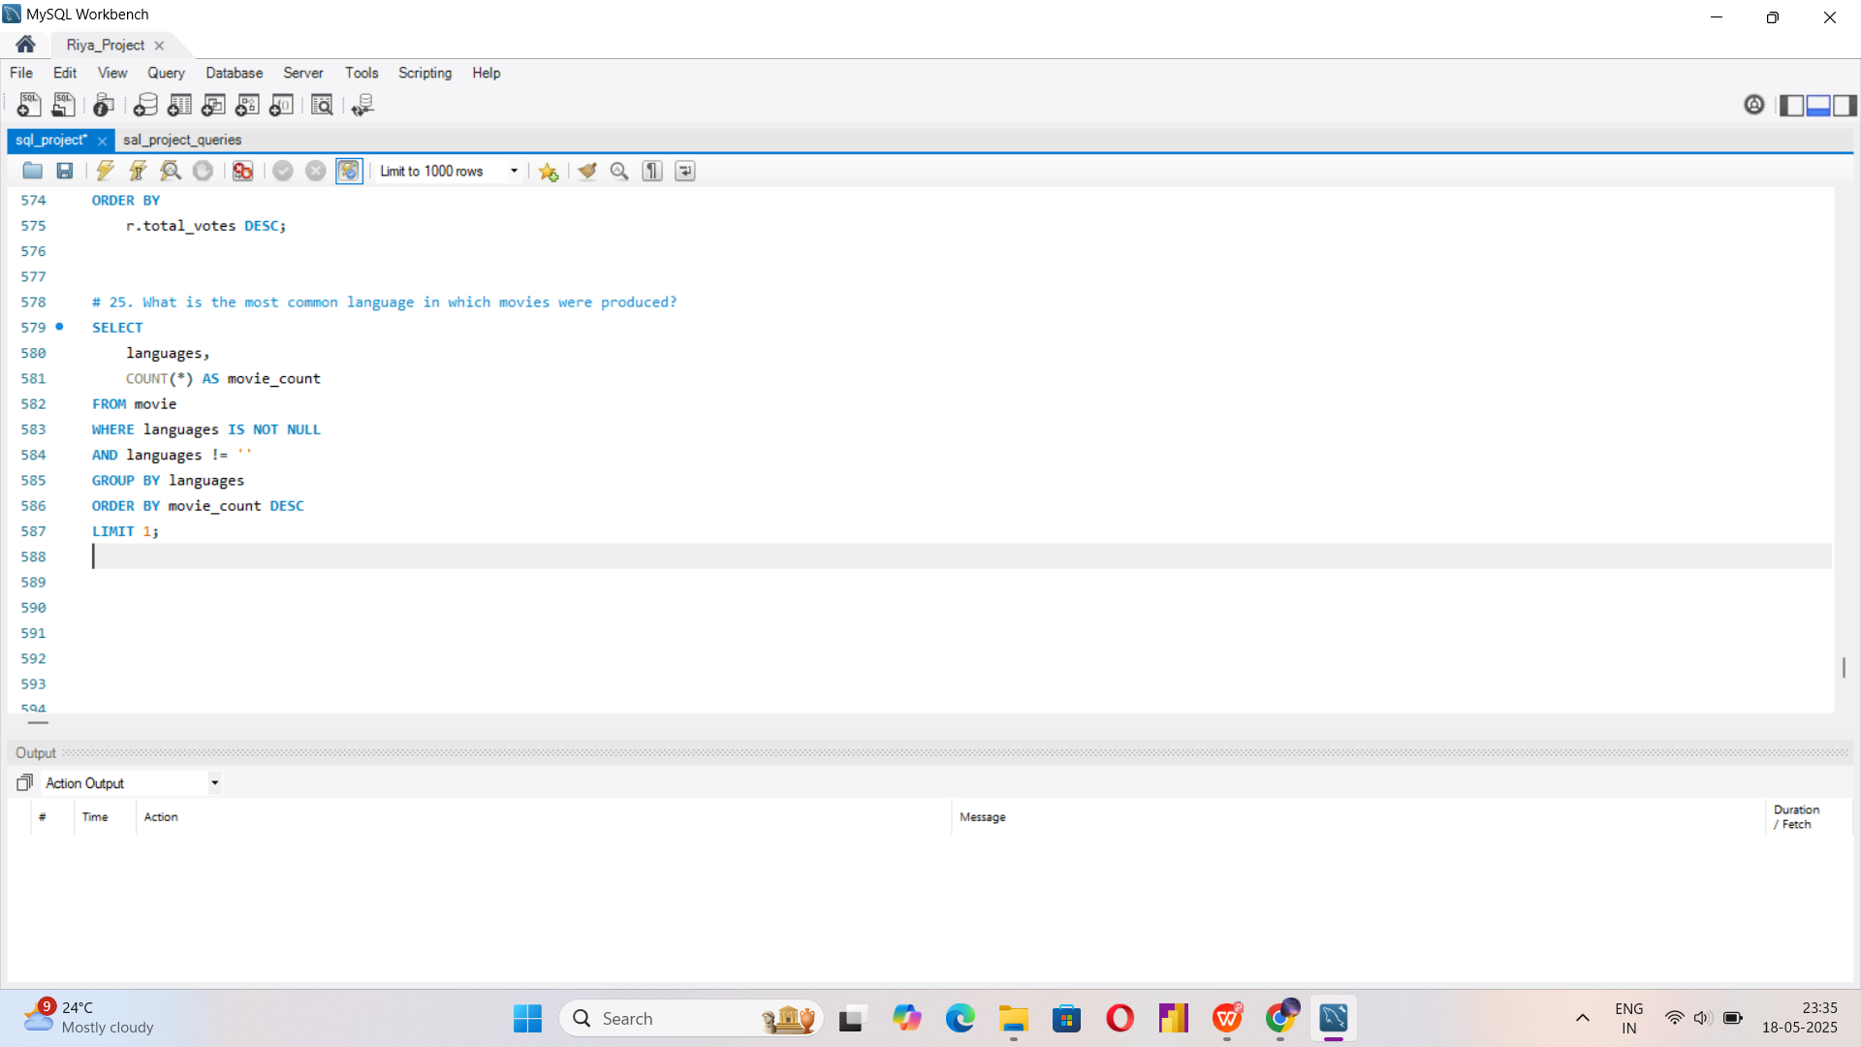
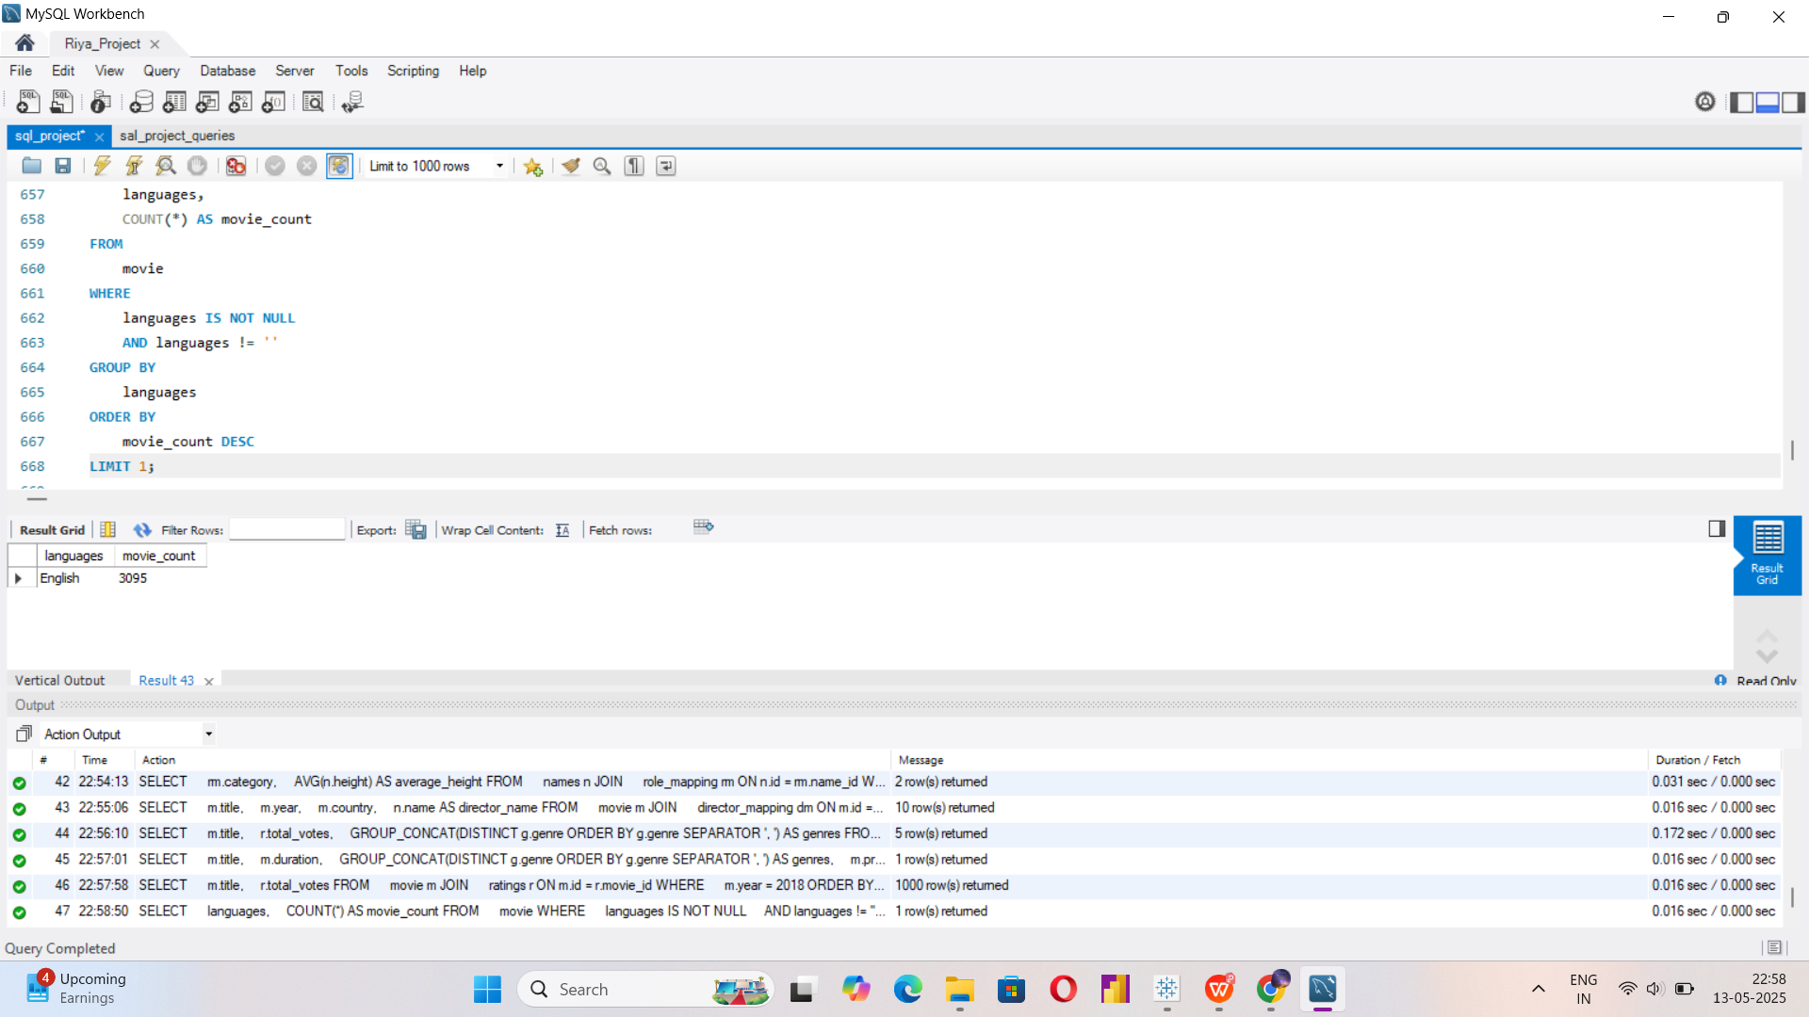

Slide 31
INSIGHTS AND CONCLUSION:
People & Participation Insights:
1. High-Performing Actors
A small group of actors has consistently starred in high-rated movies (median rating ≥ 8).
These individuals could be leveraged for trend or star-power analysis.
Useful for casting analysis or demographic profiling in film studies.
2. Directorial Experience
At least 9 directors have directed more than 3 movies, showing a substantial pool of recurring contributors.
Ideal for studying director impact on movie ratings or consistency over time.

Slide 32
INSIGHTS AND CONCLUSION:
Production & Language Trends
1. Dominant Language
English is by far the most commonly used language, appearing in 700+ movies.
This aligns with the international dominance of English-language films.
2. Top Production Companies
Marvel Studios, Twentieth Century Fox and Warner Bros. received the highest total votes, implying both popularity and reach.
These companies likely backed more prominent or globally marketed films.

Slide 33
INSIGHTS AND CONCLUSION:
Ratings and Popularity
1. Highly Rated Actors
Several actors have starred in multiple low-rated movies but only a few dominate the high-rated spectrum.
Knowing both ends helps in casting risk/reward analysis.
2. Most Popular Films
Movies like “Avengers: Infinity War", with 700,000+ votes, are fan favorites.
These can be used for marketing benchmarks or understanding genre-based engagement (e.g., Drama, Action, Adventure are common among top-voted).

Slide 34
SUMMARY RECOMMENDATIONS:
Focus marketing & analytics around actors and production companies with proven high-rated outputs.
Clean and normalize multi-value fields (e.g., genres, languages) for better aggregation and filtering.
Segment audience and genre trends over time using year/month and language/country splits.

Slide 35

THANK YOU

